Slide 1
Nebraska Climate Update
CARC Meeting
28 November, 2022
Martha E Durr
mdurr9@unl.edu
402-472-6711
School of natural resources
University of Nebraska LIncoln

Slide 2
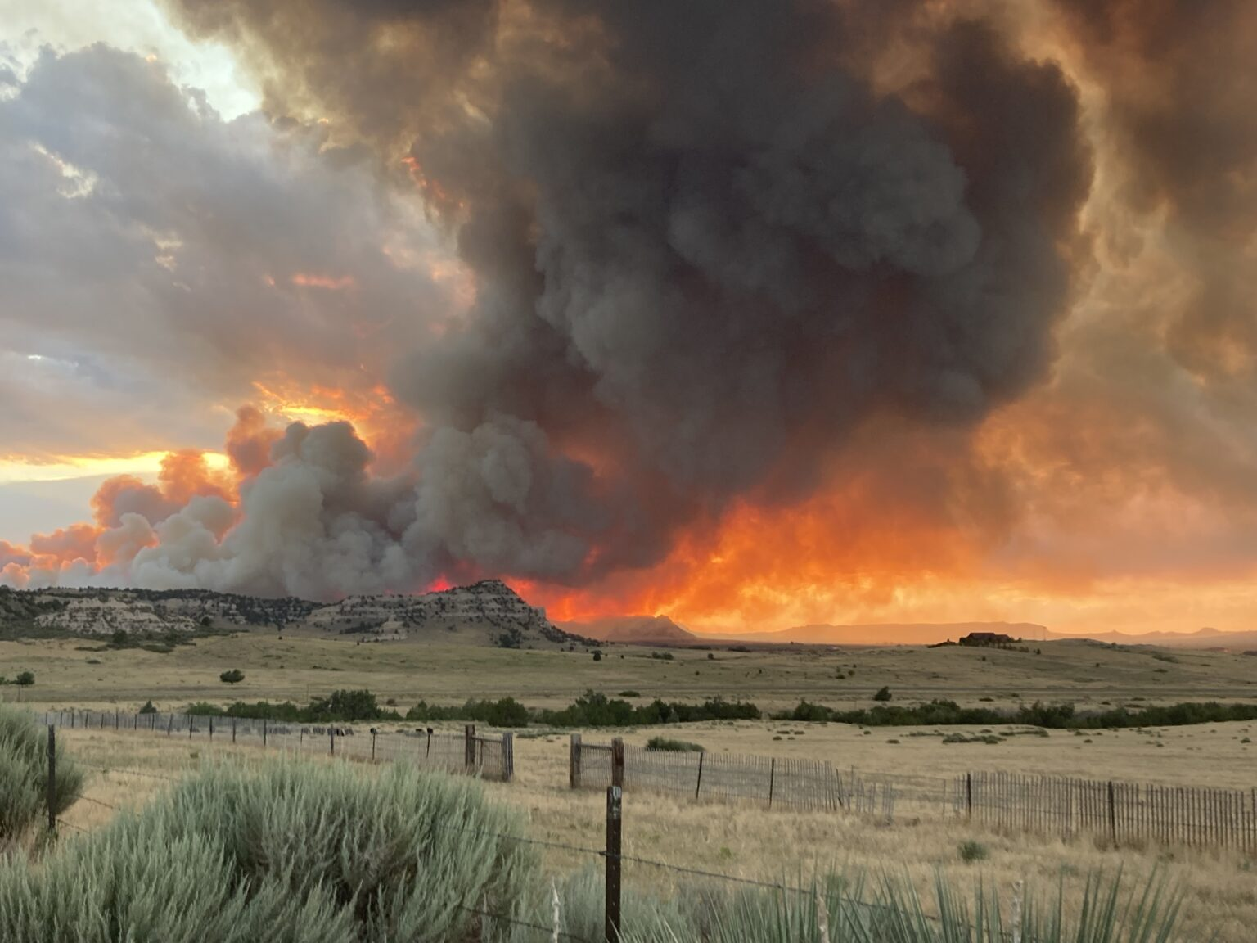
Outline
Drought in perspective
Current conditions, moisture deficits
Impacts
Climate outlook
Drought outlook
https://nebraskaexaminer.com/2022/11/07/nebraska-on-pace-for-second-worst-wildfire-year-ever-2023-outlook-is-dim/
Notes:
Here I outlined the similar trends for the Nebraska and global annual average temperature. I also point out the high variability in Nebraska and difference in regional vs. global scales. I use the analogy that global change is like an escalator that is increasing at an accelerating rate. The variability is like we jump up or down a few steps while still going up.

Slide 3
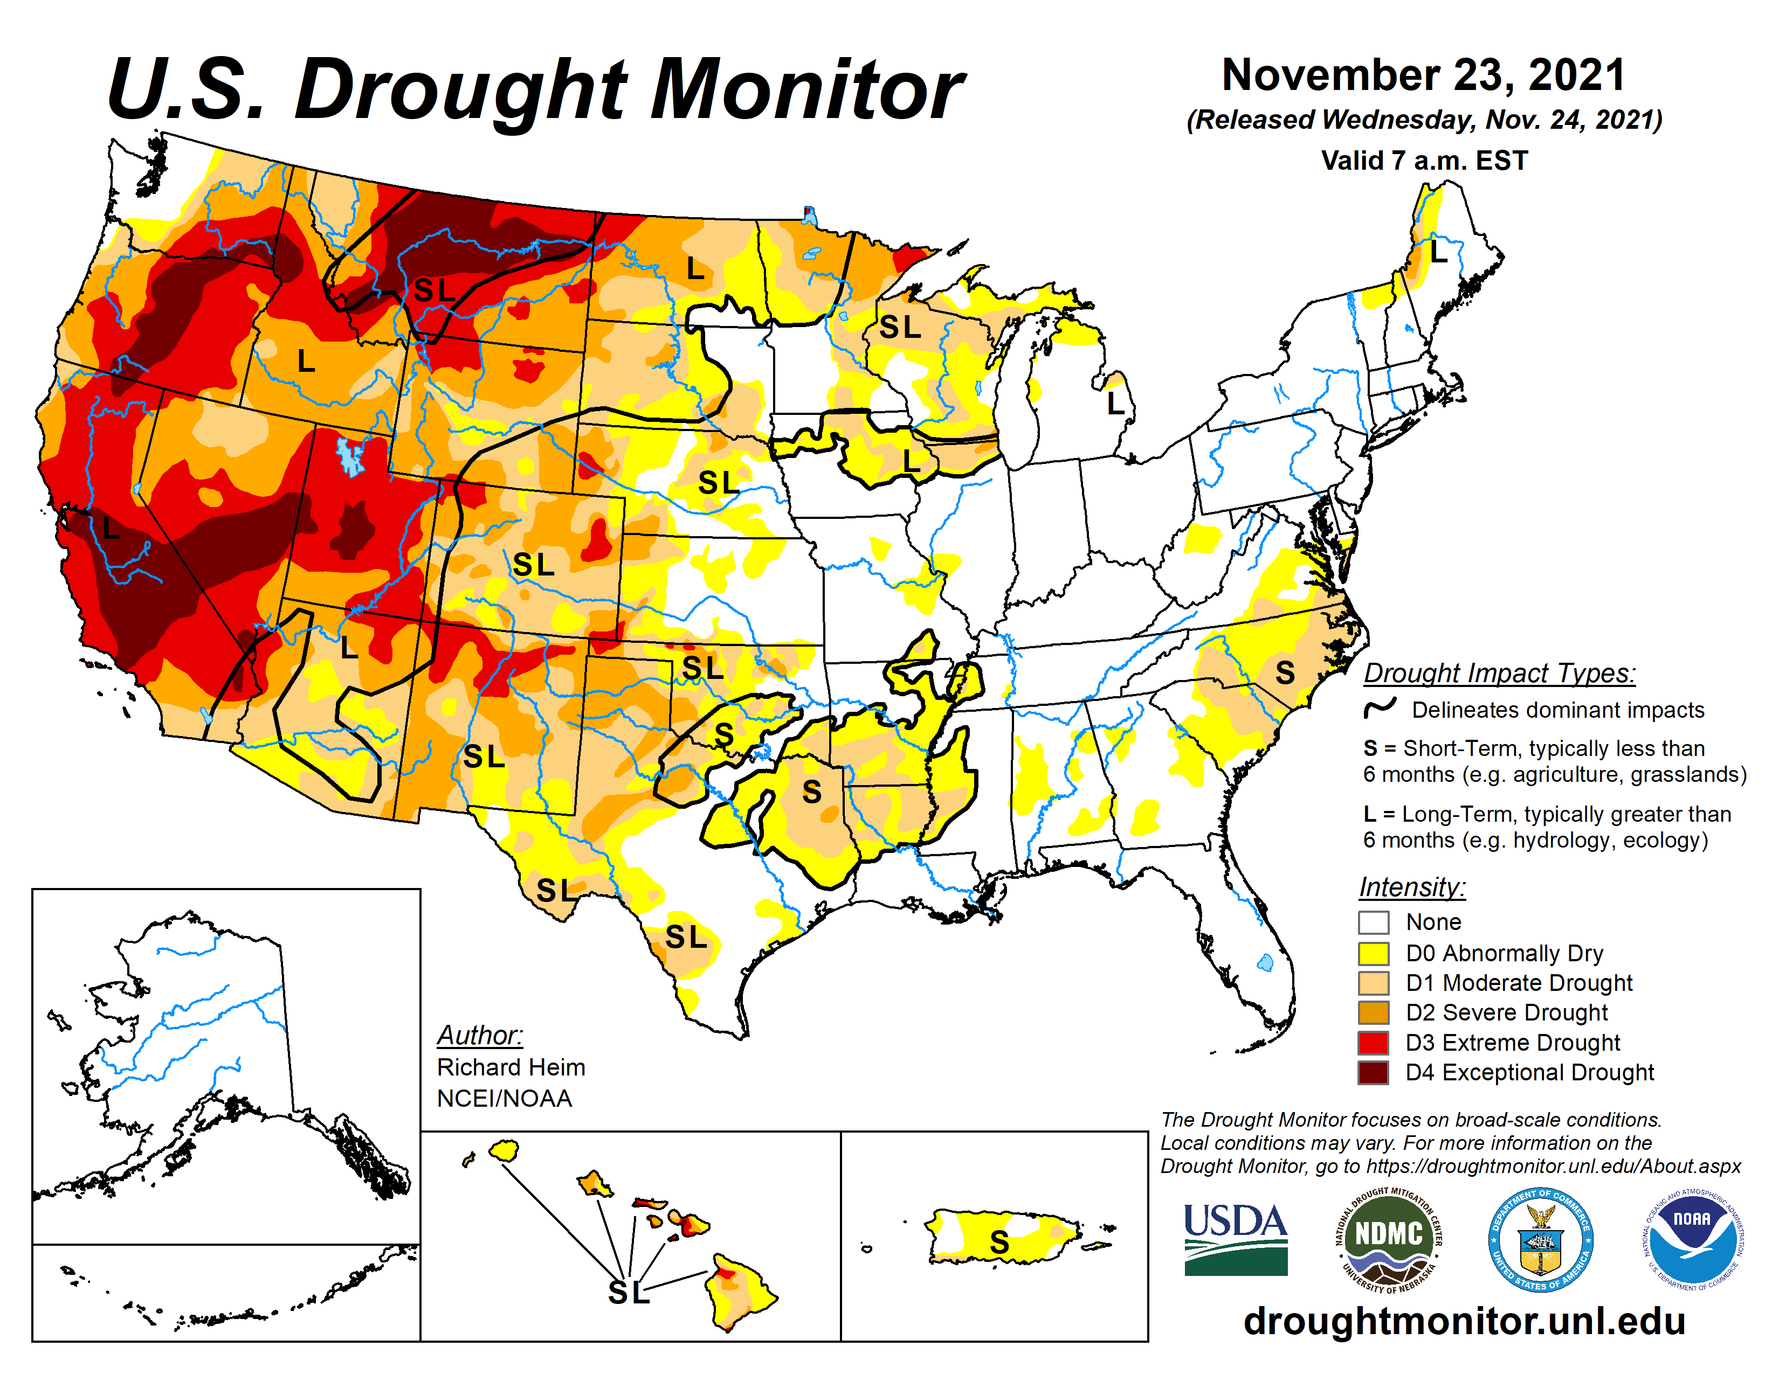
Drought in perspective
Conditions one year ago:
42% of U.S. in drought.
Drought present throughout west.
Notes:
Here I outlined the similar trends for the Nebraska and global annual average temperature. I also point out the high variability in Nebraska and difference in regional vs. global scales. I use the analogy that global change is like an escalator that is increasing at an accelerating rate. The variability is like we jump up or down a few steps while still going up.

Slide 4
Drought in perspective
Conditions one year ago:
42% of U.S. in drought.
Drought present throughout west.
32% of Nebraska in drought. Short and long-term dryness.
Source: https://droughtmonitor.unl.edu/maps/
Notes:
Here I outlined the similar trends for the Nebraska and global annual average temperature. I also point out the high variability in Nebraska and difference in regional vs. global scales. I use the analogy that global change is like an escalator that is increasing at an accelerating rate. The variability is like we jump up or down a few steps while still going up.

Slide 5
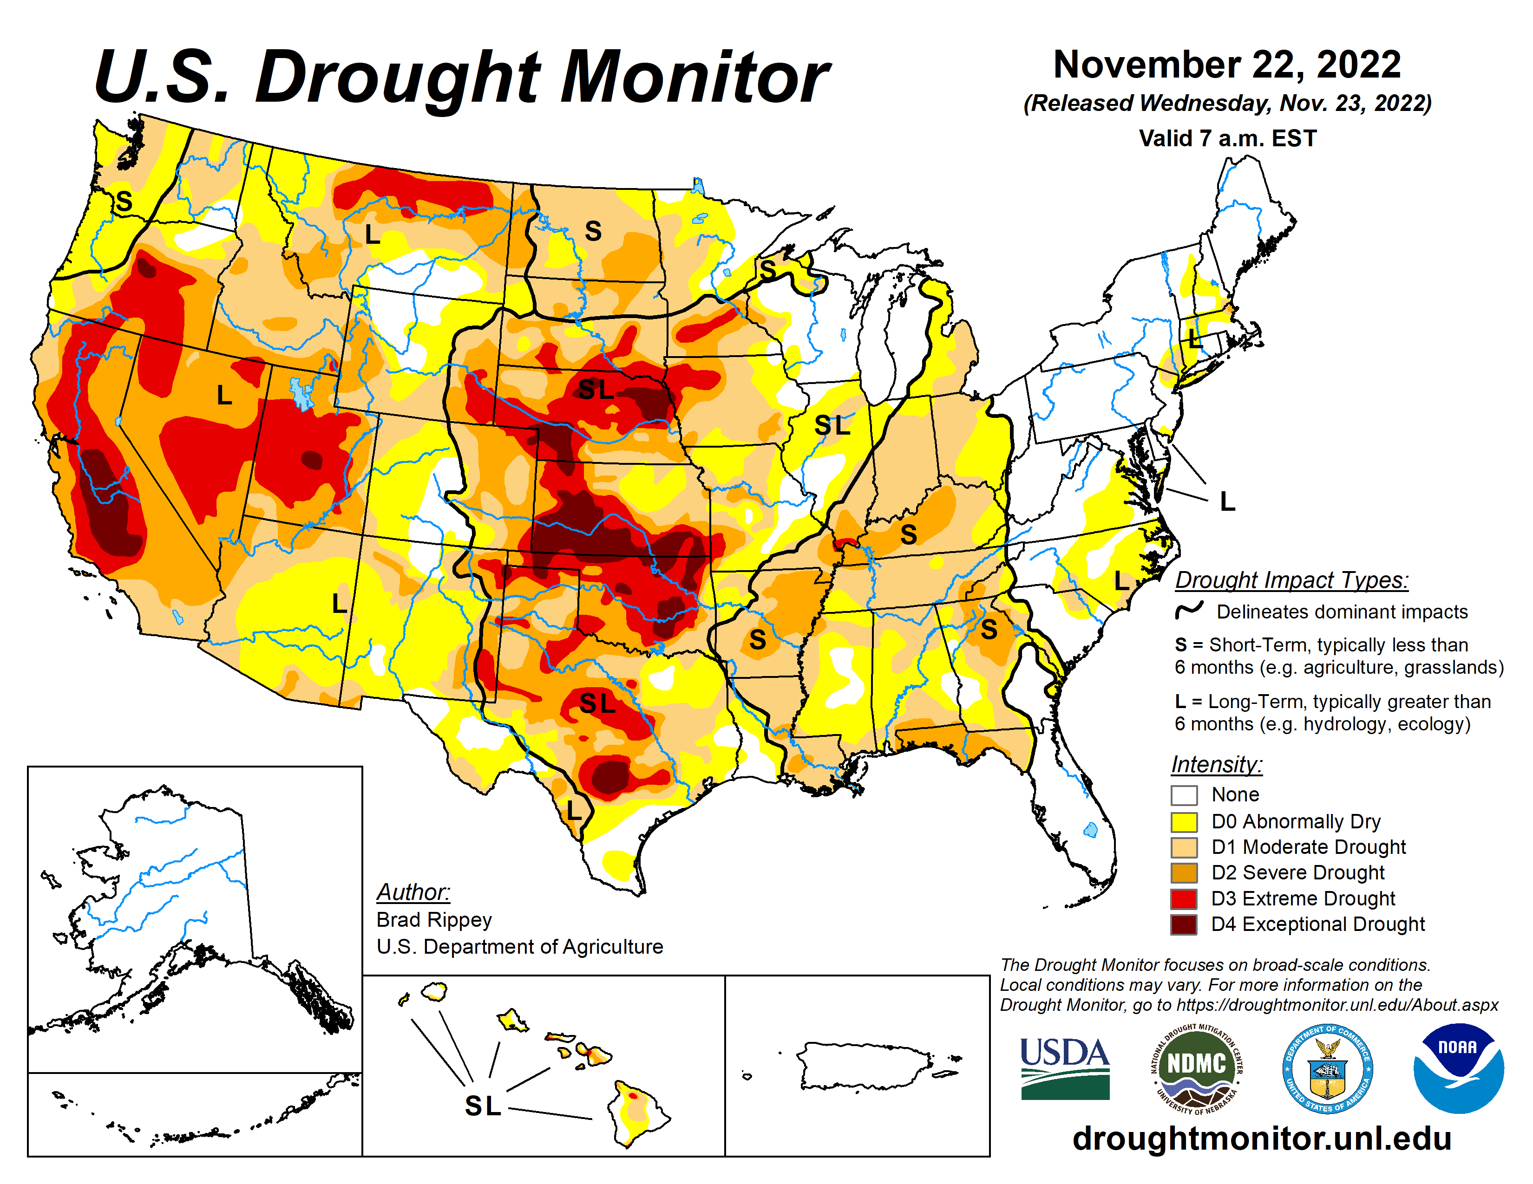
Drought in perspective
Conditions now:
50% of U.S. in drought.
Drought expansion eastward.
Some alleviation in west with active monsoon season.
All of Nebraska in drought.
Source: https://droughtmonitor.unl.edu/maps/
Notes:
Here I outlined the similar trends for the Nebraska and global annual average temperature. I also point out the high variability in Nebraska and difference in regional vs. global scales. I use the analogy that global change is like an escalator that is increasing at an accelerating rate. The variability is like we jump up or down a few steps while still going up.

Slide 6
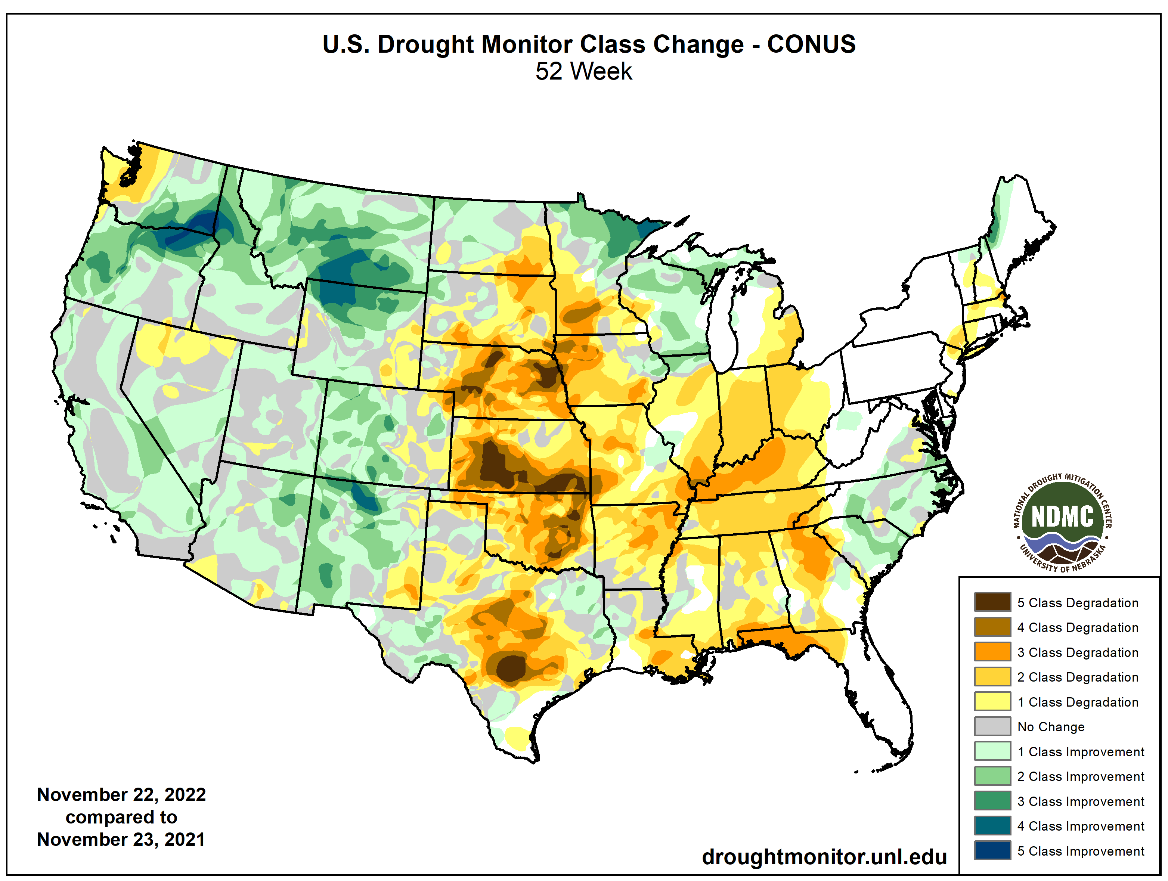
Drought in perspective
Conditions now:
Intensification across central, southern Plains over the past year.
Source: https://droughtmonitor.unl.edu/maps/
Notes:
Here I outlined the similar trends for the Nebraska and global annual average temperature. I also point out the high variability in Nebraska and difference in regional vs. global scales. I use the analogy that global change is like an escalator that is increasing at an accelerating rate. The variability is like we jump up or down a few steps while still going up.

Slide 7
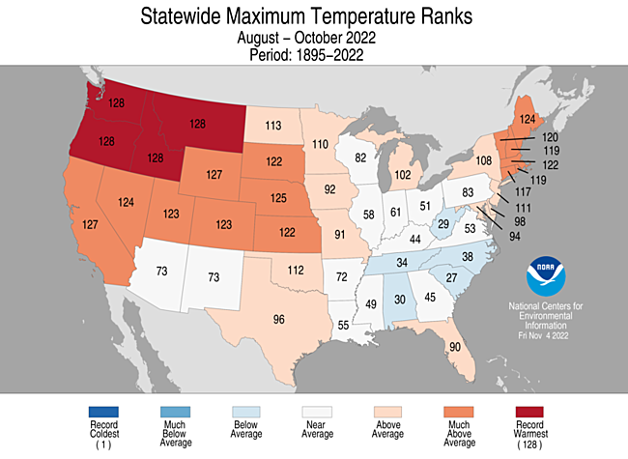
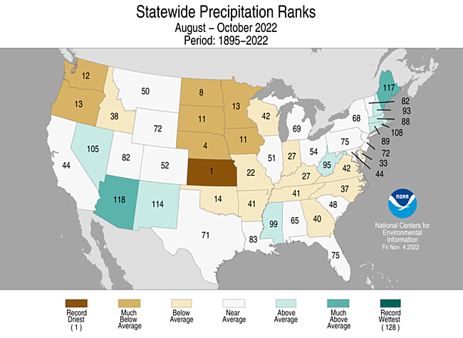
Cause for worsening conditions
Aug – Oct 4th warmest for daytime highs
4th driest on record
Notes:
Here I outlined the similar trends for the Nebraska and global annual average temperature. I also point out the high variability in Nebraska and difference in regional vs. global scales. I use the analogy that global change is like an escalator that is increasing at an accelerating rate. The variability is like we jump up or down a few steps while still going up.

Slide 8
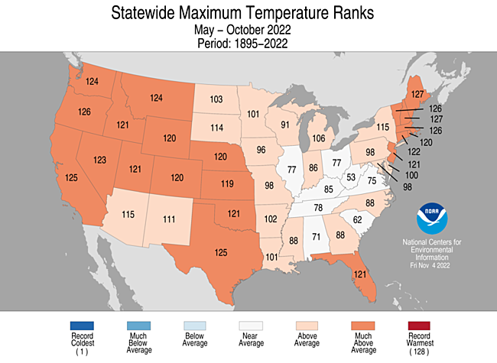
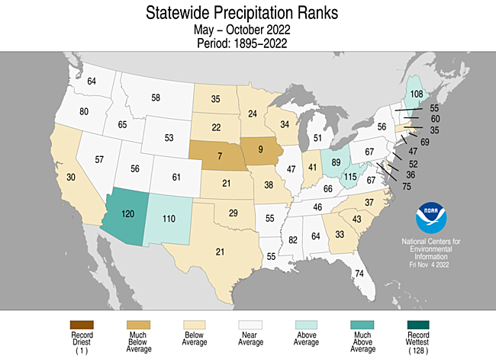
Cause for worsening conditions
May – Oct 8th warmest for daytime highs
7th driest on record
Notes:
Here I outlined the similar trends for the Nebraska and global annual average temperature. I also point out the high variability in Nebraska and difference in regional vs. global scales. I use the analogy that global change is like an escalator that is increasing at an accelerating rate. The variability is like we jump up or down a few steps while still going up.

Slide 9
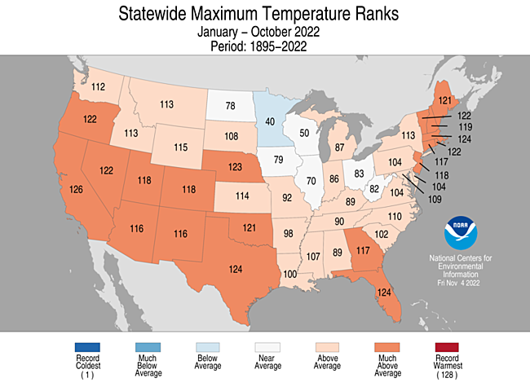
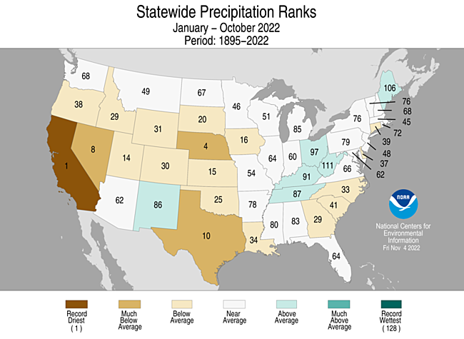
Cause for worsening conditions
Jan – Oct 6th warmest for daytime highs
4th driest on record
Notes:
Here I outlined the similar trends for the Nebraska and global annual average temperature. I also point out the high variability in Nebraska and difference in regional vs. global scales. I use the analogy that global change is like an escalator that is increasing at an accelerating rate. The variability is like we jump up or down a few steps while still going up.

Slide 10
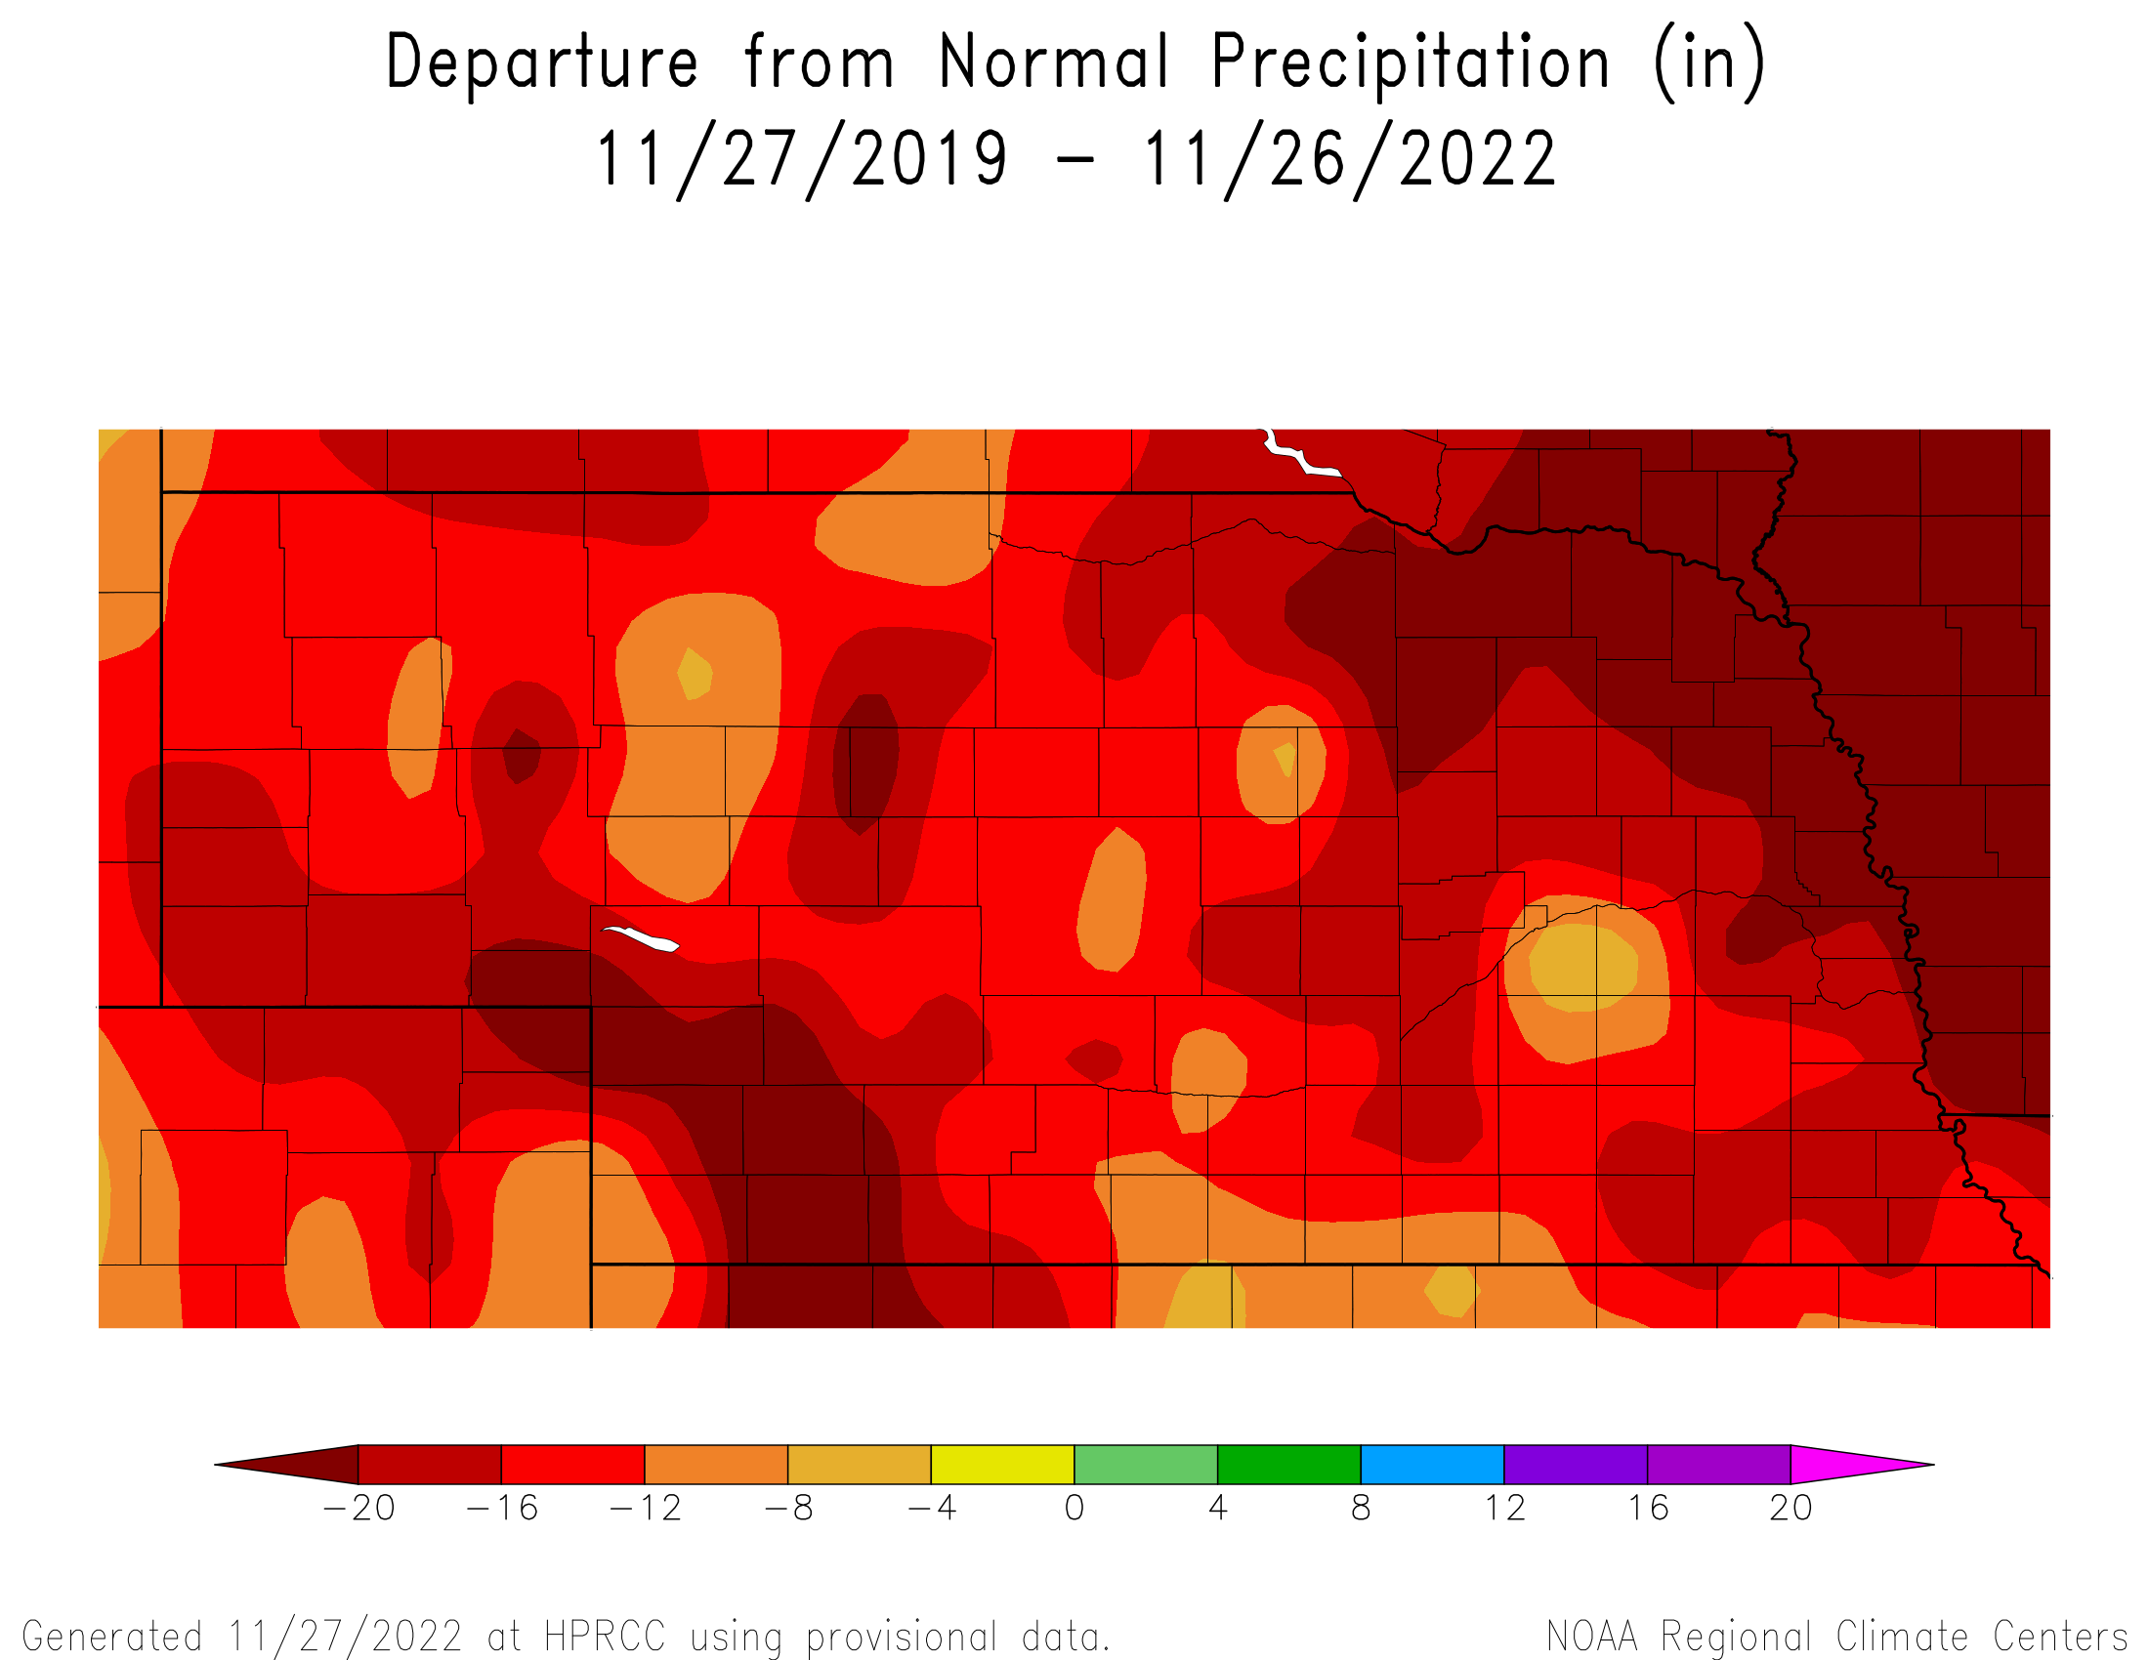
Long-term moisture deficits
2019 to Present
3-year precipitation deficits for much of the state in 12” range or worse.
Southwest and northeast have 20+ inch moisture deficits.
Notes:
Here I outlined the similar trends for the Nebraska and global annual average temperature. I also point out the high variability in Nebraska and difference in regional vs. global scales. I use the analogy that global change is like an escalator that is increasing at an accelerating rate. The variability is like we jump up or down a few steps while still going up.

Slide 11
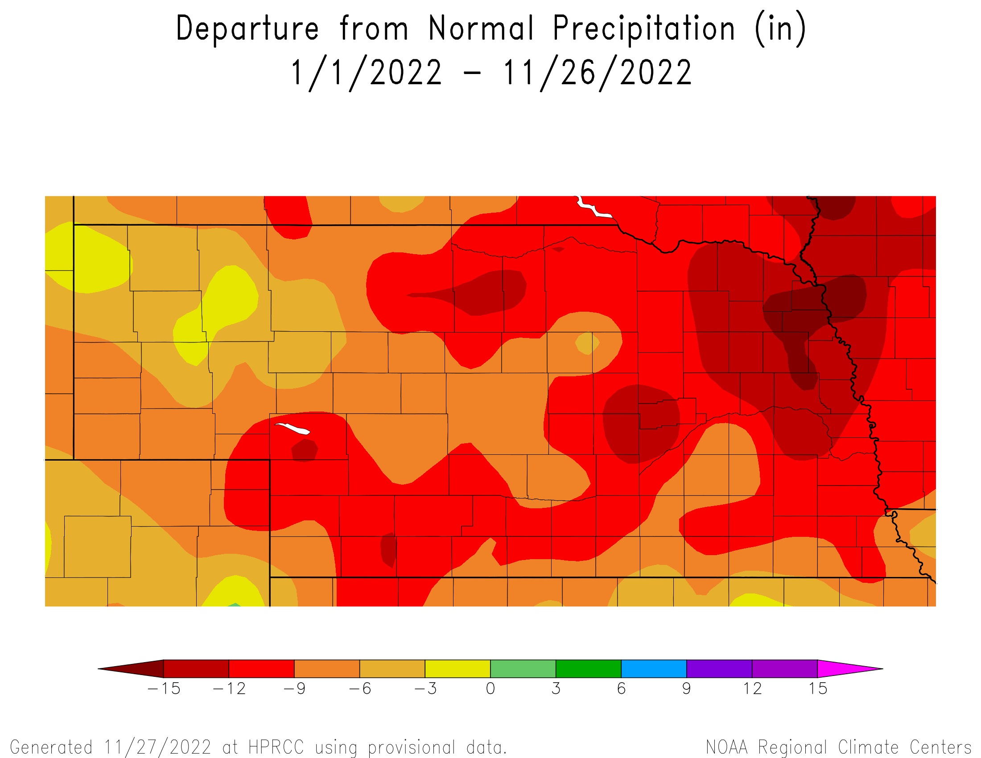
2022 moisture deficits
January to Present
9” or worse deficits for southwest, central and eastern Nebraska.
12 – 15” deficits in pockets and most notably for the northeast.
Notes:
Here I outlined the similar trends for the Nebraska and global annual average temperature. I also point out the high variability in Nebraska and difference in regional vs. global scales. I use the analogy that global change is like an escalator that is increasing at an accelerating rate. The variability is like we jump up or down a few steps while still going up.

Slide 12
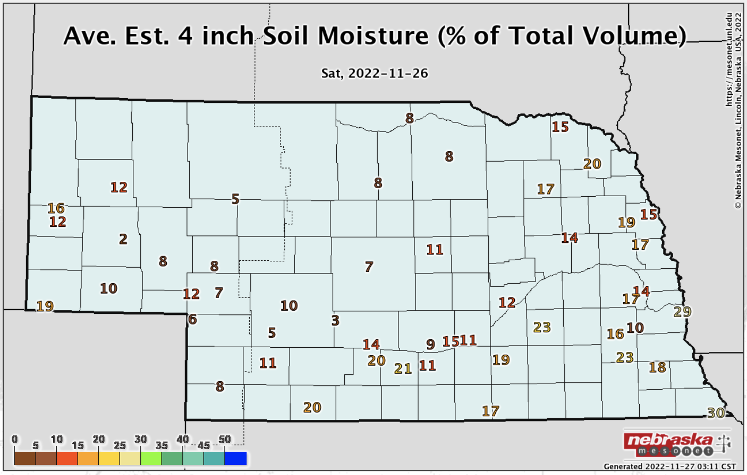
Impacts – Soil moisture
- Soil water content varies by soil type.
Conditions are indicative of the dryness.
Statewide NASS Topsoil: 86% short/vs Subsoil: 90% short/vs
Notes:
Here I outlined the similar trends for the Nebraska and global annual average temperature. I also point out the high variability in Nebraska and difference in regional vs. global scales. I use the analogy that global change is like an escalator that is increasing at an accelerating rate. The variability is like we jump up or down a few steps while still going up.

Slide 13
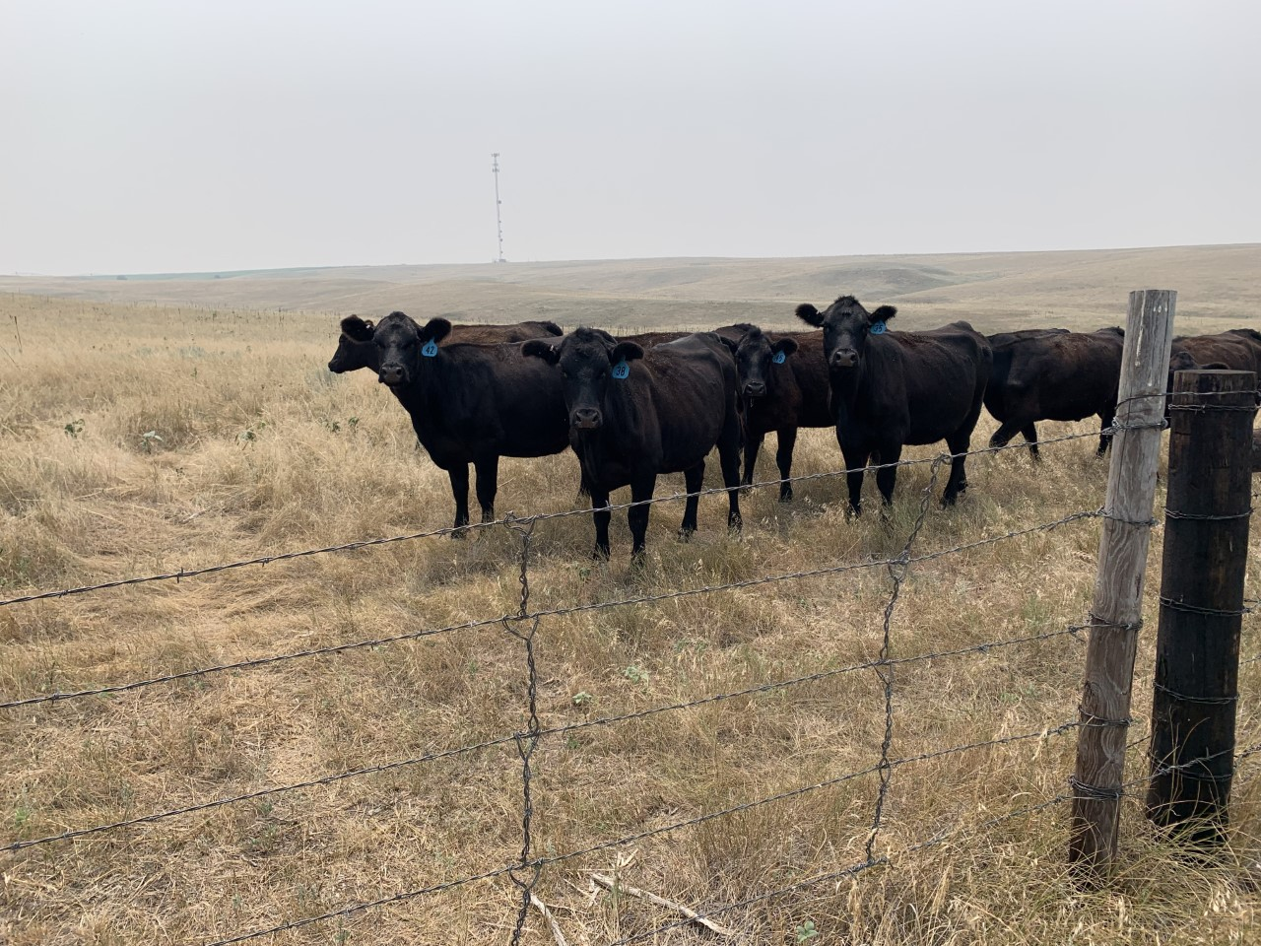
Impacts – pasture/range
Statewide NASS condition: 77% poor / very poor 4% good
Notes:
Here I outlined the similar trends for the Nebraska and global annual average temperature. I also point out the high variability in Nebraska and difference in regional vs. global scales. I use the analogy that global change is like an escalator that is increasing at an accelerating rate. The variability is like we jump up or down a few steps while still going up.

Slide 14
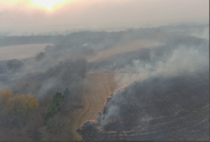
Impacts – fires
Nebraska has 2nd worst wildfire year in 2022.
~200,000 acres have burned so far this year.
(502,000 in 2012)
Windy conditions will continue to result in high fire danger.
Notes:
Here I outlined the similar trends for the Nebraska and global annual average temperature. I also point out the high variability in Nebraska and difference in regional vs. global scales. I use the analogy that global change is like an escalator that is increasing at an accelerating rate. The variability is like we jump up or down a few steps while still going up.

Slide 15
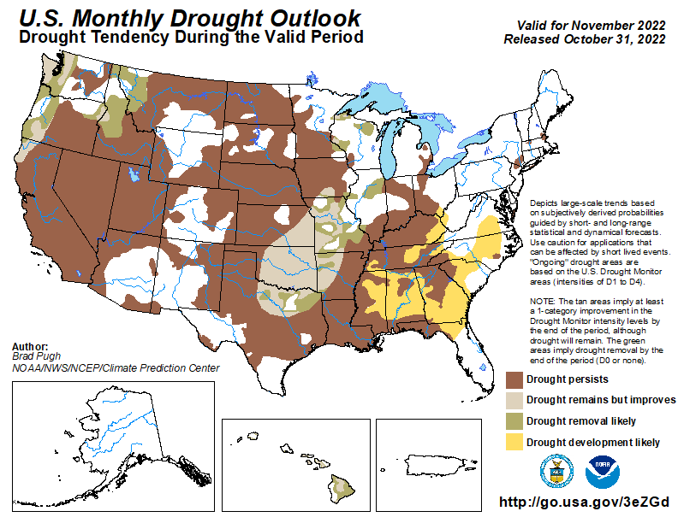
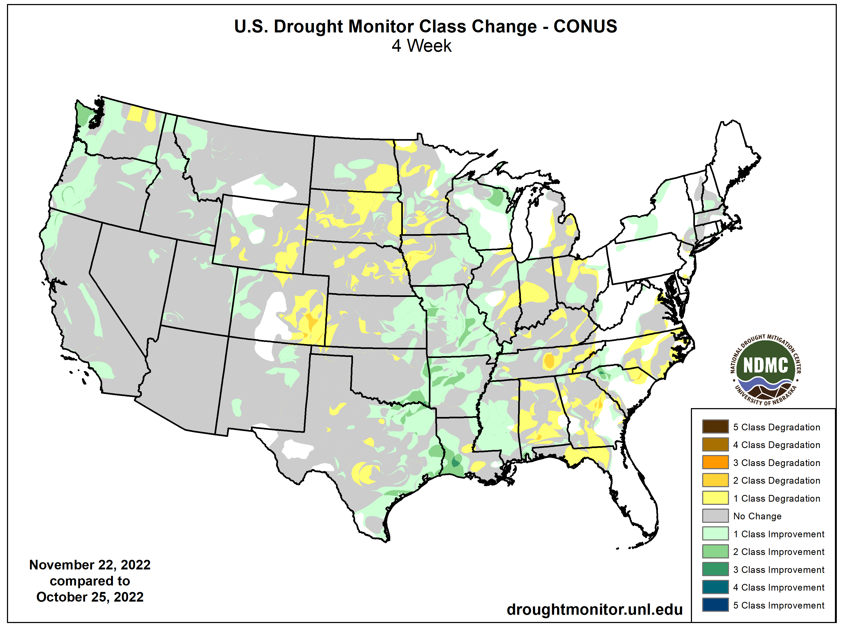
November drought ‘verification’
Drought persistence across Nebraska.
https://www.cpc.ncep.noaa.gov/
Notes:
Here I outlined the similar trends for the Nebraska and global annual average temperature. I also point out the high variability in Nebraska and difference in regional vs. global scales. I use the analogy that global change is like an escalator that is increasing at an accelerating rate. The variability is like we jump up or down a few steps while still going up.

Slide 16
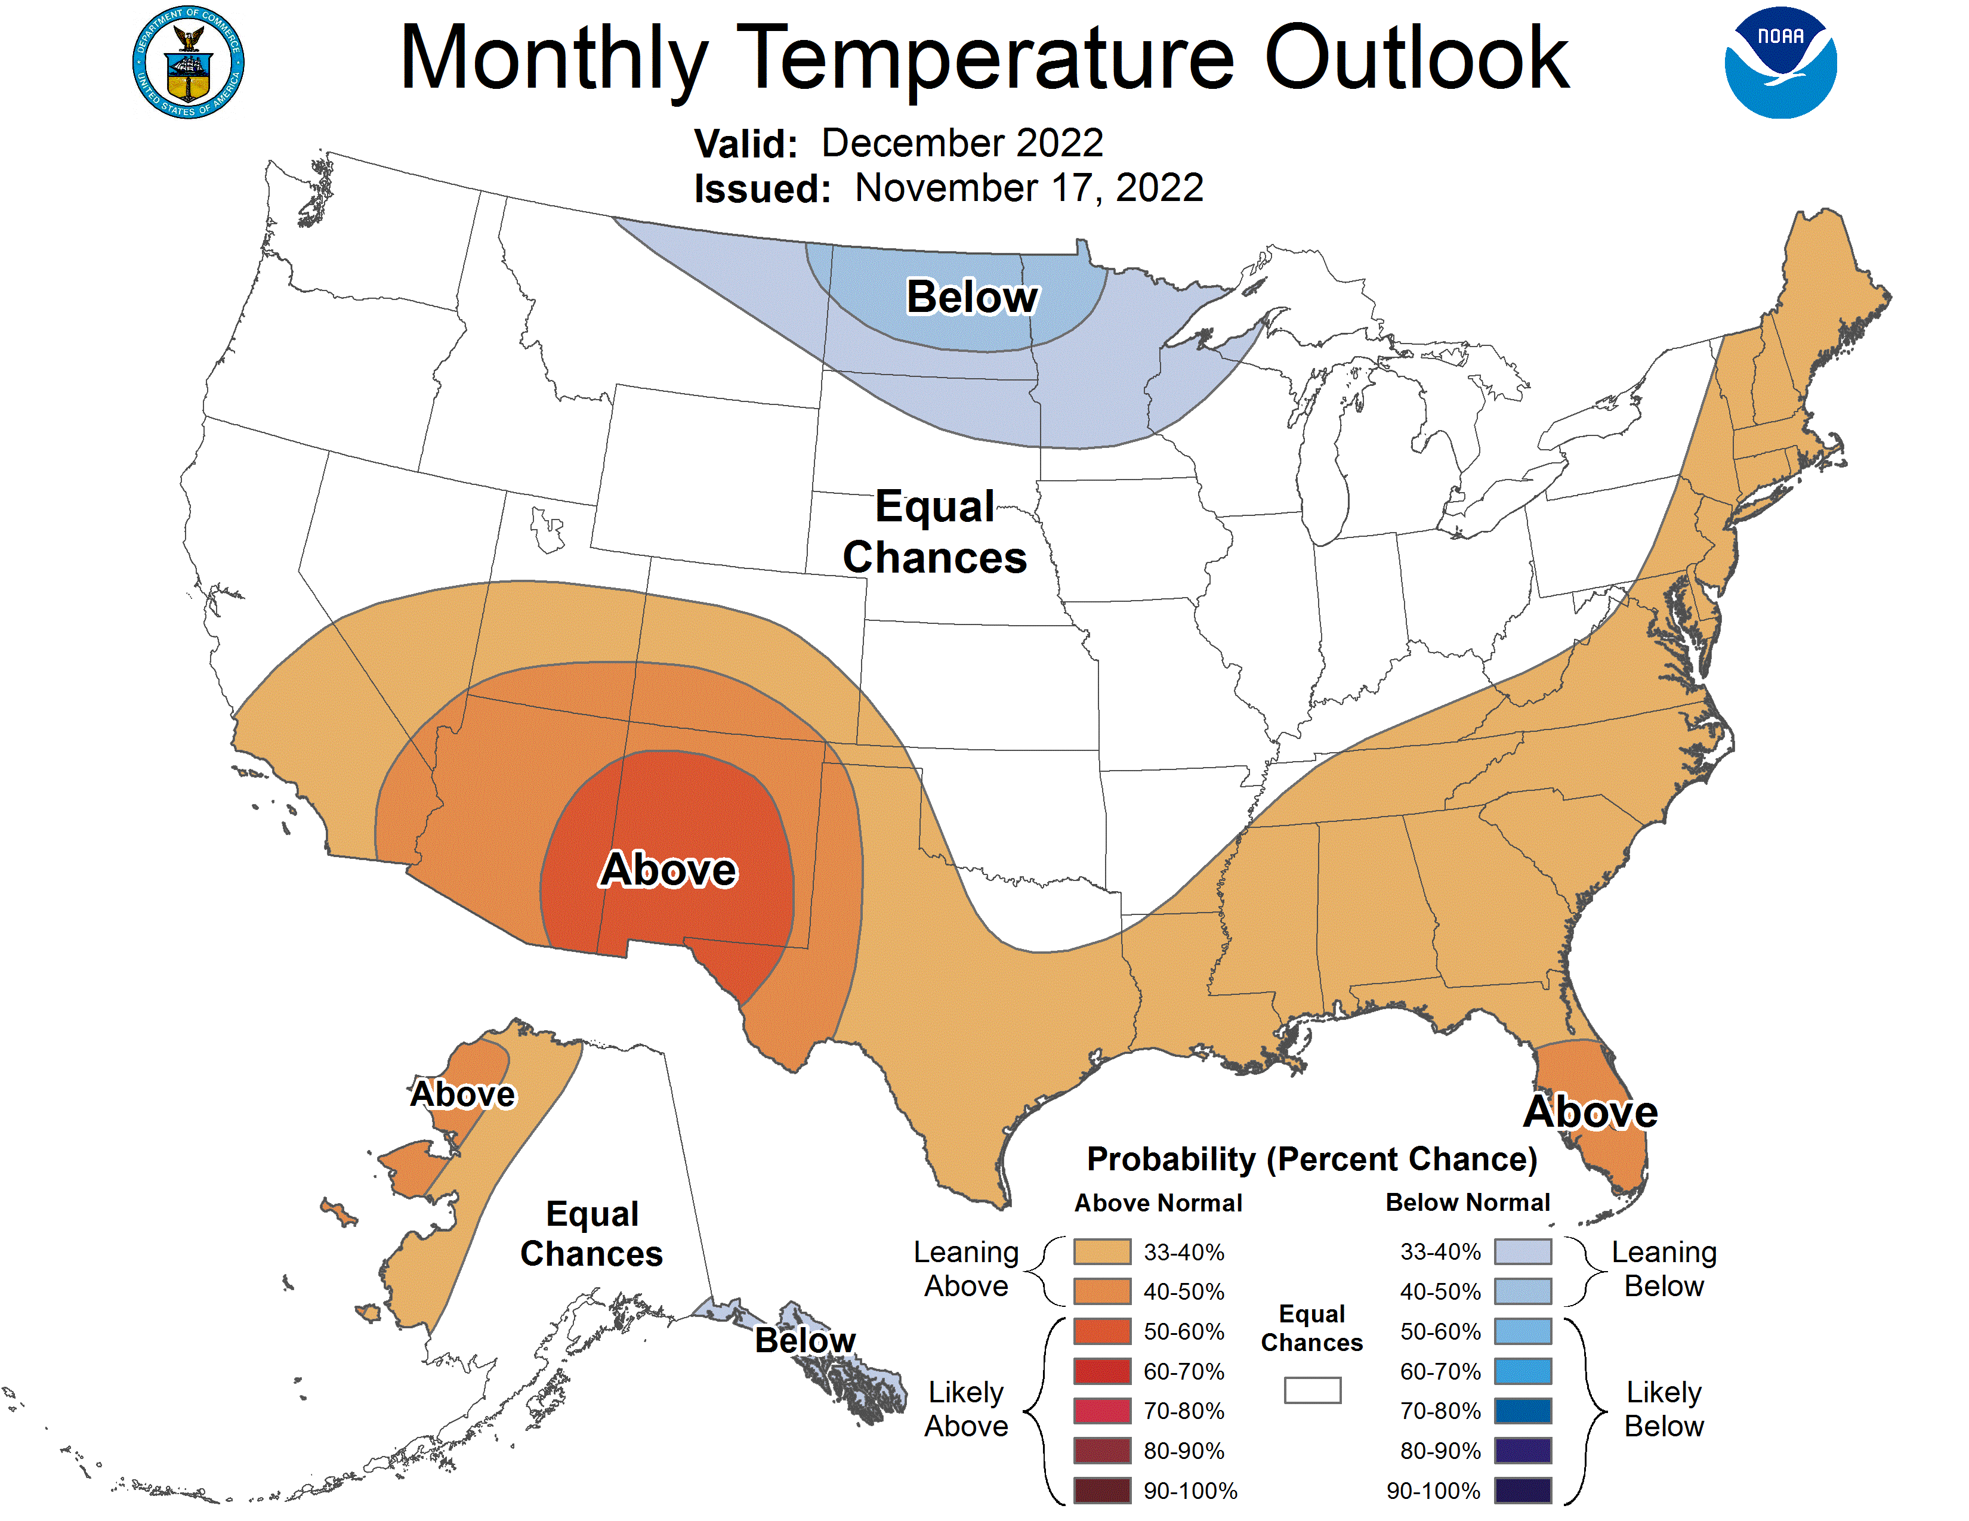
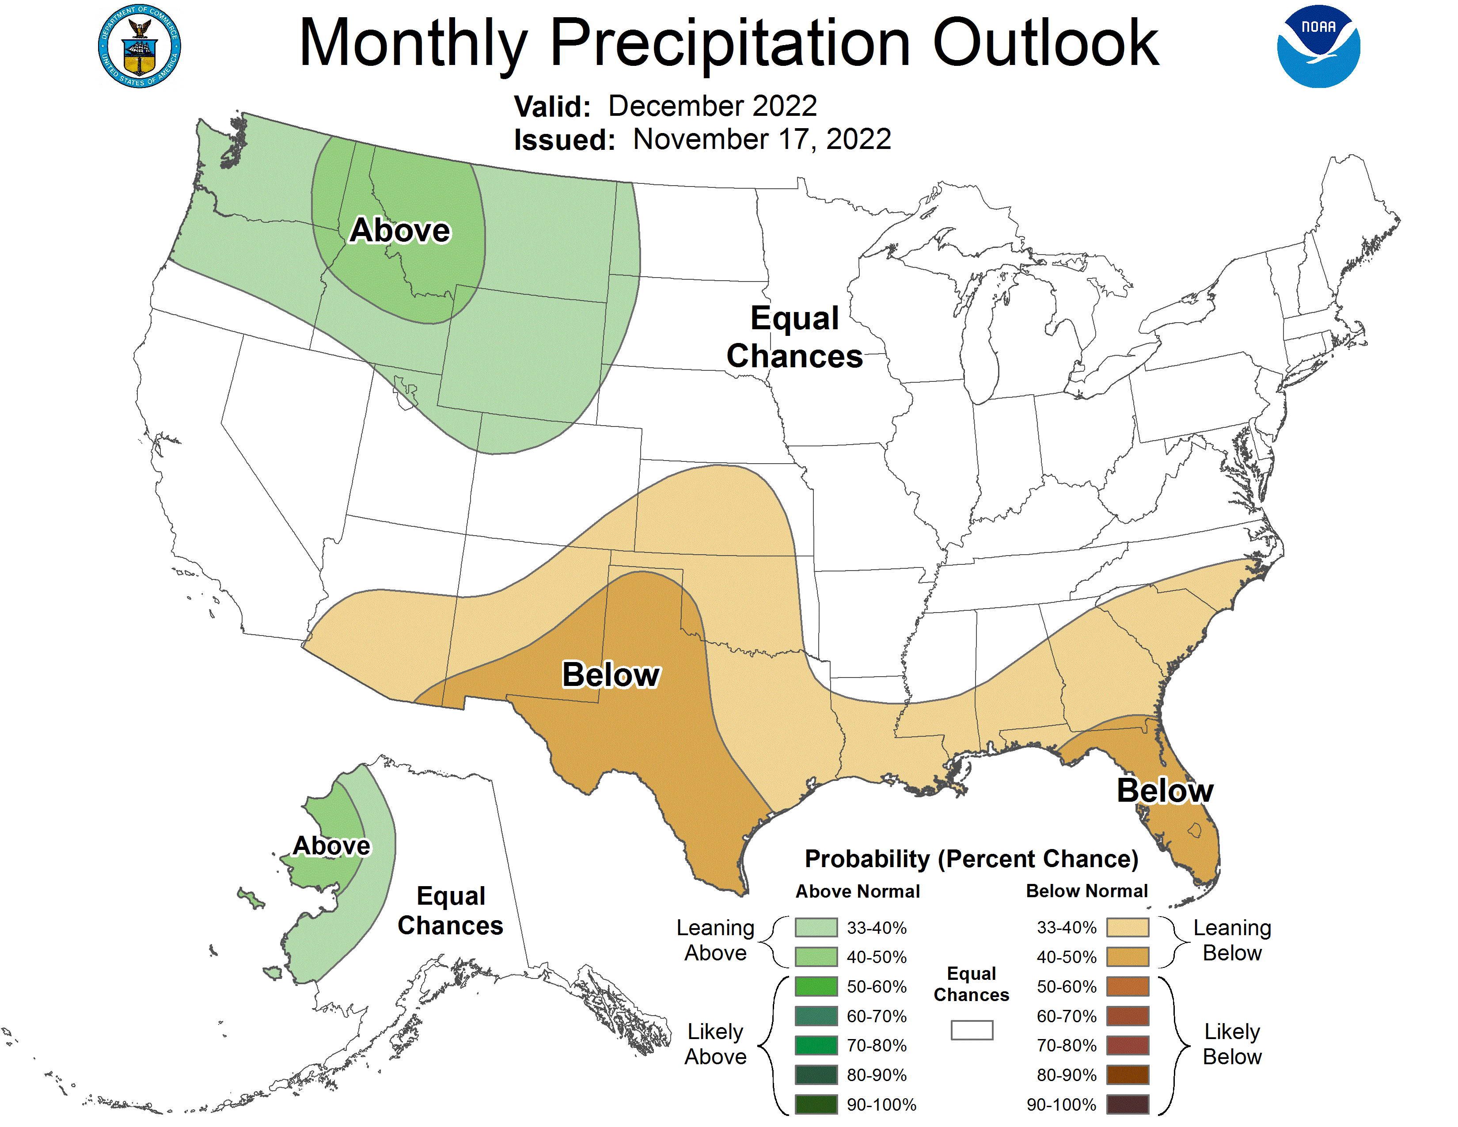
December climate outlook
Warmer than normal tendency for much of Nebraska. Precipitation is in equal chances category without strong indication of wetter/drier than normal.
https://www.cpc.ncep.noaa.gov/
Notes:
Here I outlined the similar trends for the Nebraska and global annual average temperature. I also point out the high variability in Nebraska and difference in regional vs. global scales. I use the analogy that global change is like an escalator that is increasing at an accelerating rate. The variability is like we jump up or down a few steps while still going up.

Slide 17
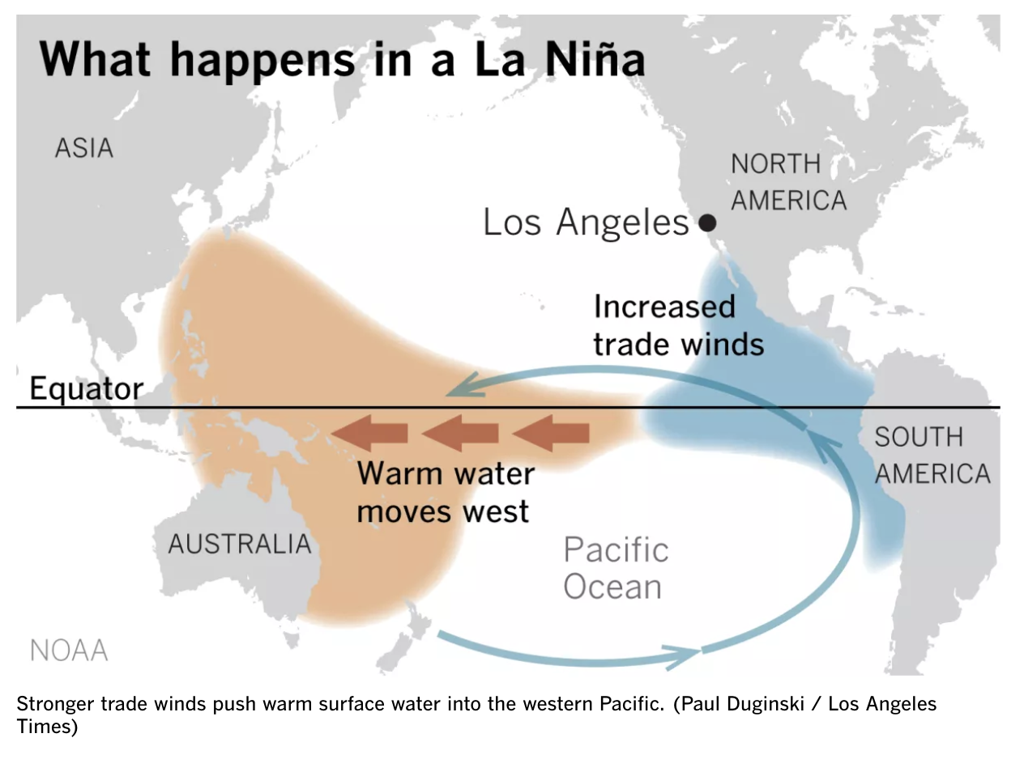
La Niña – why does it matter?
https://www.latimes.com/california/story/2022-03-03/california-drought-australia-floods-la-nina-climate-change
Notes:
Here I outlined the similar trends for the Nebraska and global annual average temperature. I also point out the high variability in Nebraska and difference in regional vs. global scales. I use the analogy that global change is like an escalator that is increasing at an accelerating rate. The variability is like we jump up or down a few steps while still going up.

Slide 18
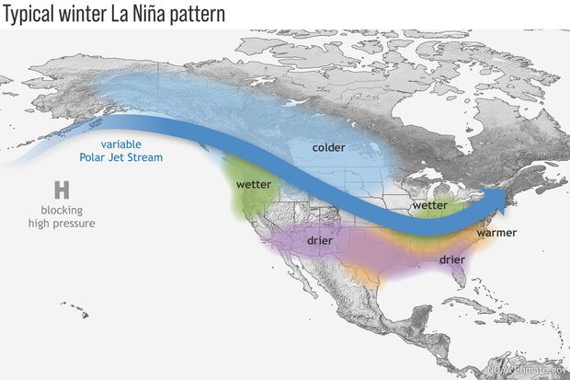
La Niña – why does it matter?
While no two La Niña events are alike, this is the typical setup for North America.
Pattern leads to cool/wet conditions across the north, warm/dry to our south.
https://www.climate.gov/enso
Notes:
Here I outlined the similar trends for the Nebraska and global annual average temperature. I also point out the high variability in Nebraska and difference in regional vs. global scales. I use the analogy that global change is like an escalator that is increasing at an accelerating rate. The variability is like we jump up or down a few steps while still going up.

Slide 19
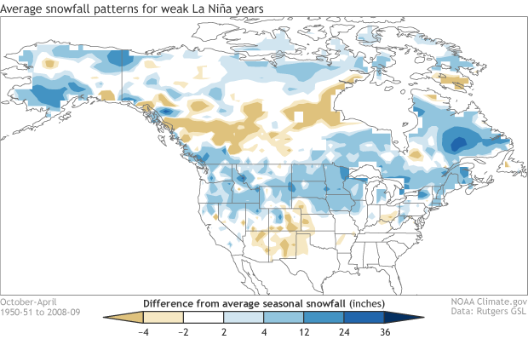
Snow during weak La Niña winters
- On average, snow tends to be higher than average in the northern Great Plains during weak La Niña years.
https://www.climate.gov/news-features/blogs/enso/what-about-snow-during-la-ni%C3%B1a-winters
Notes:
Here I outlined the similar trends for the Nebraska and global annual average temperature. I also point out the high variability in Nebraska and difference in regional vs. global scales. I use the analogy that global change is like an escalator that is increasing at an accelerating rate. The variability is like we jump up or down a few steps while still going up.

Slide 20
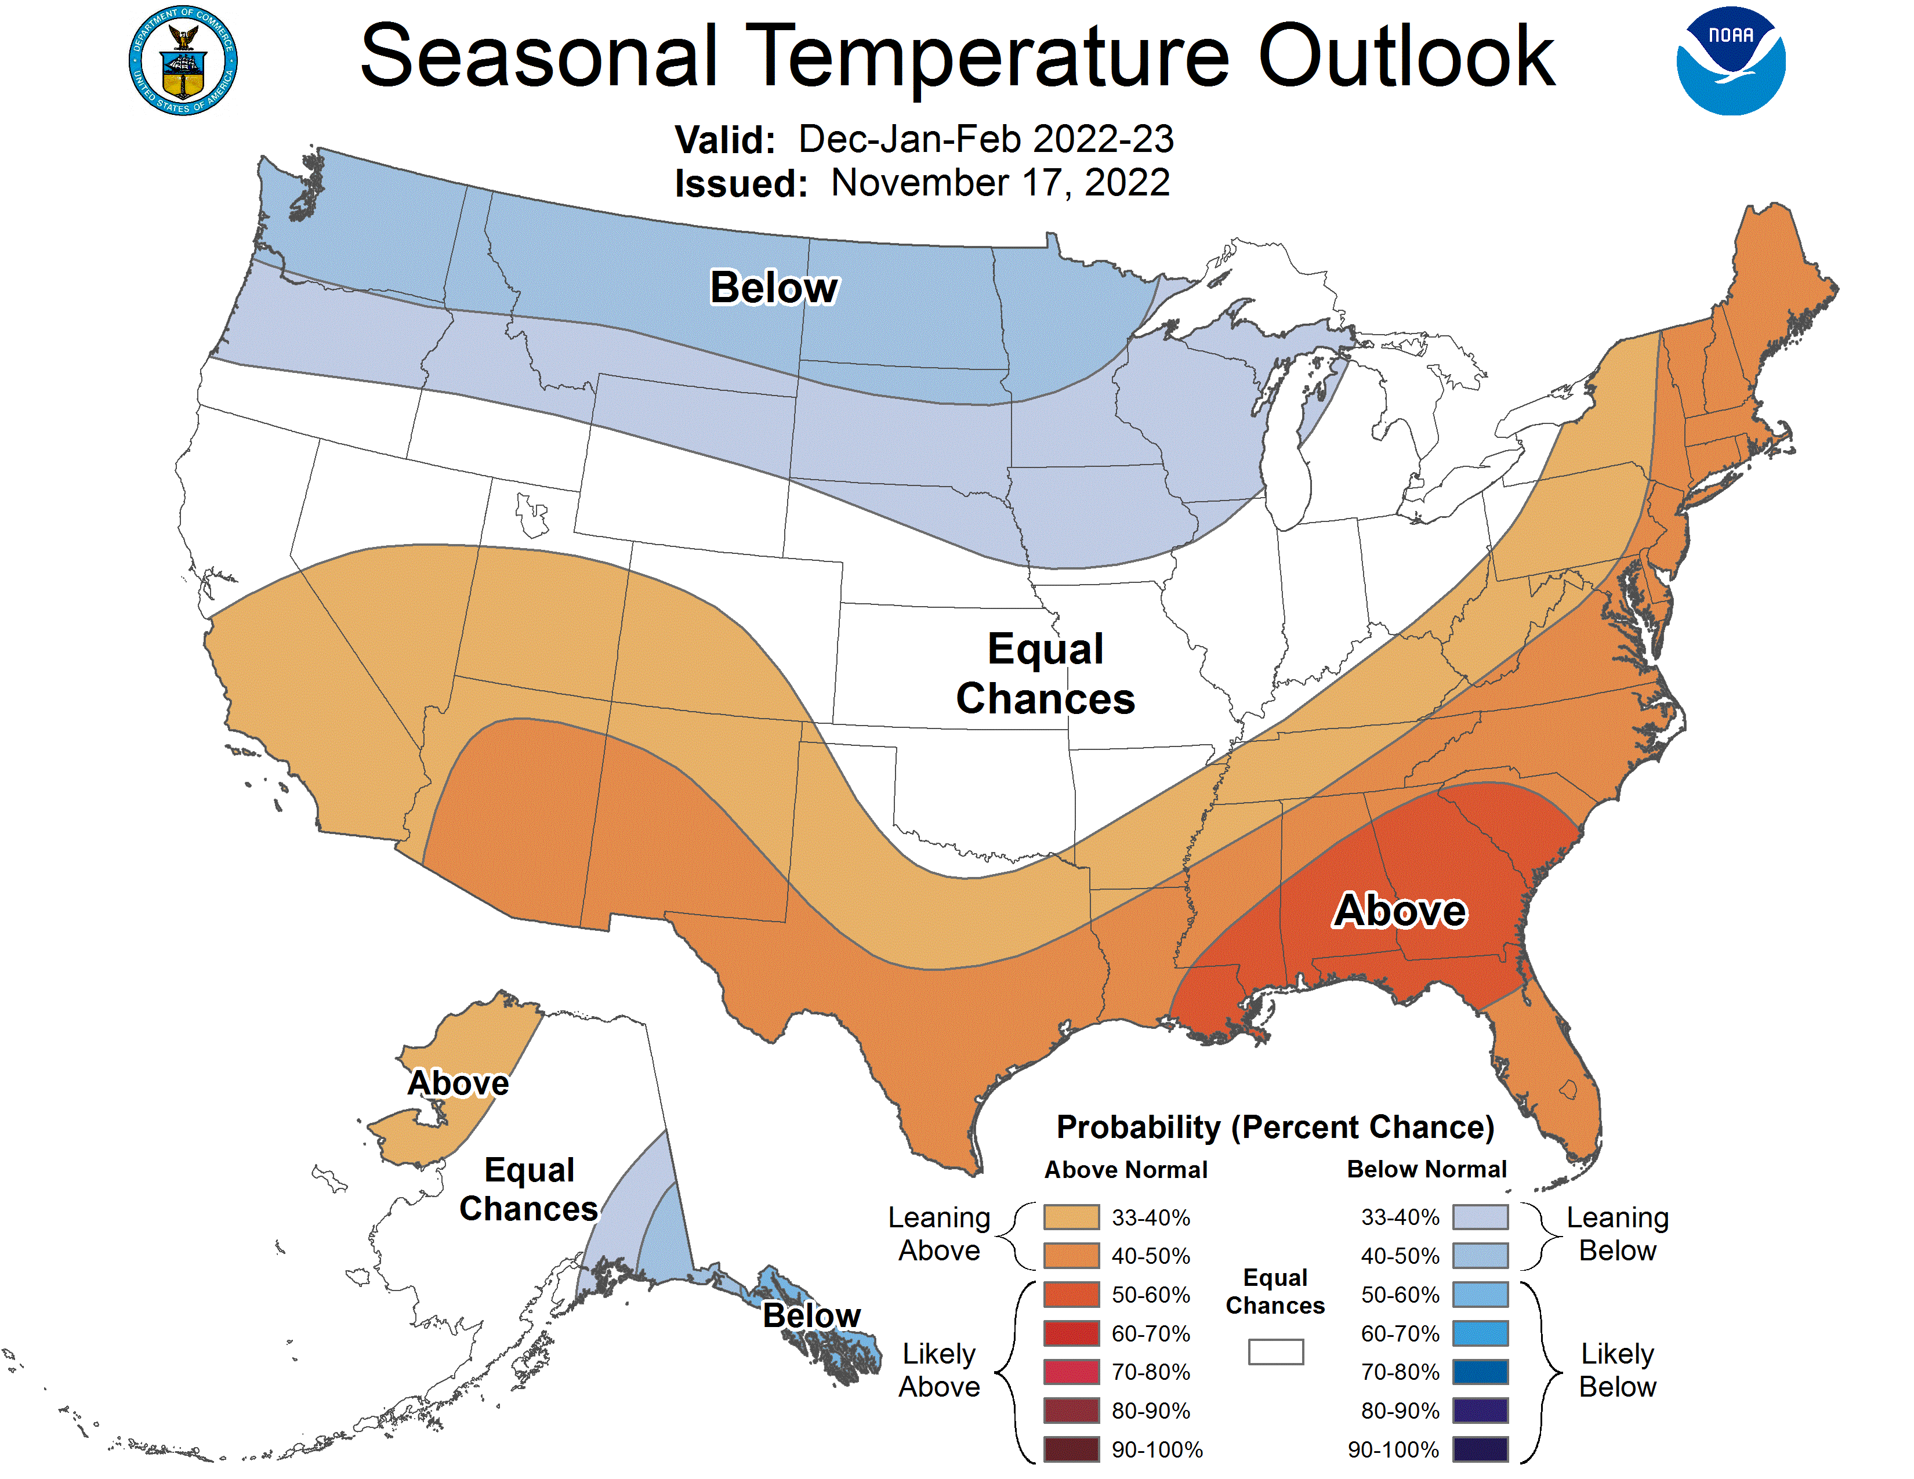
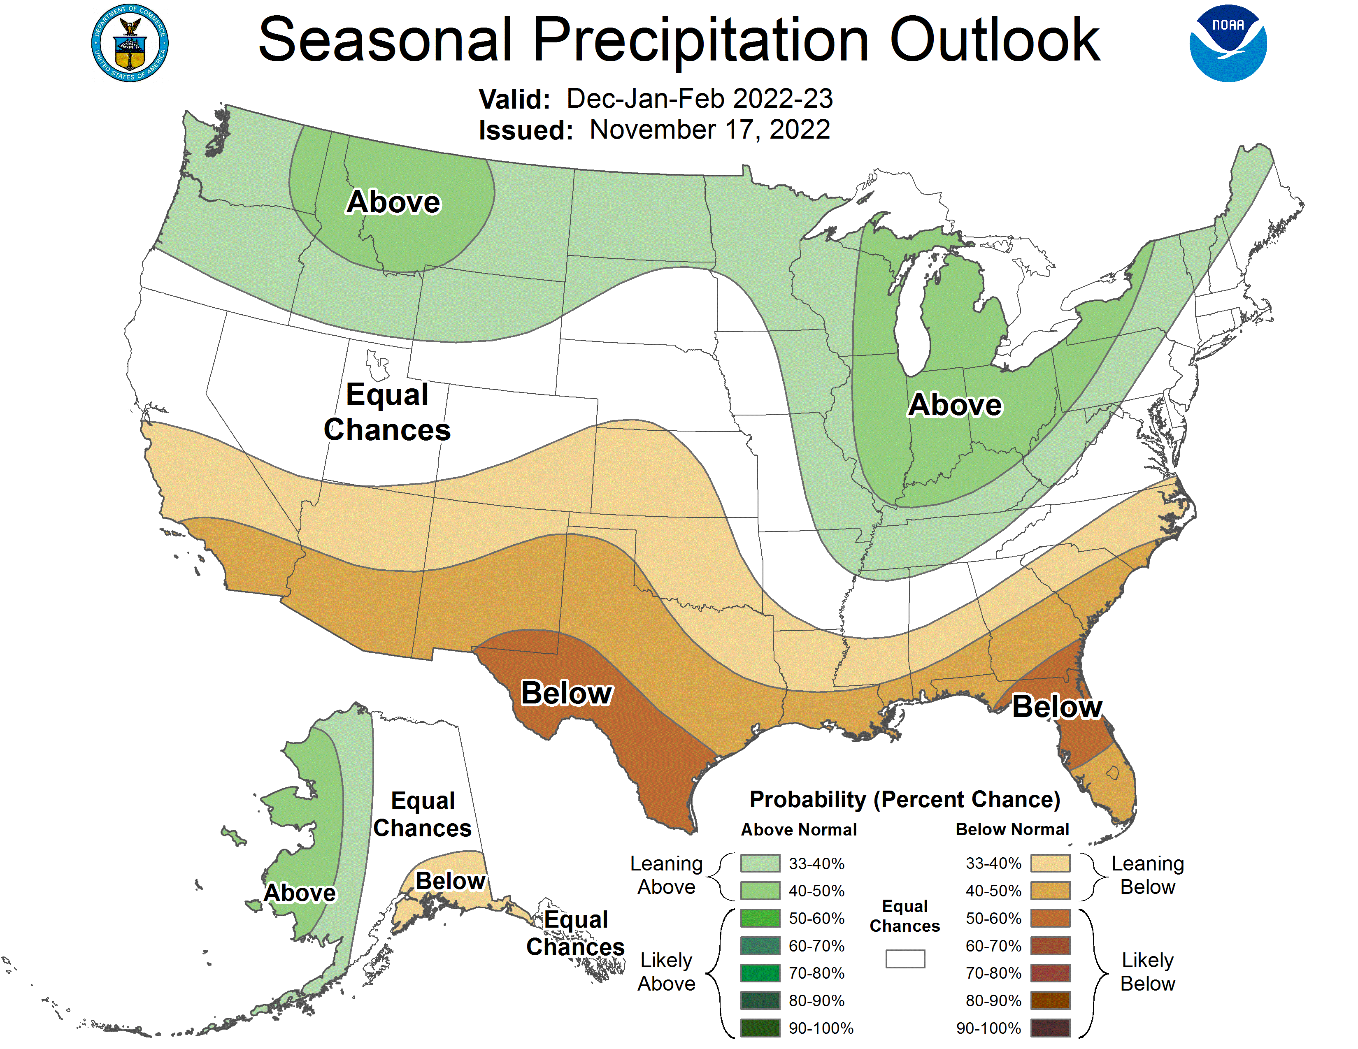
Seasonal outlook (Dec - Feb)
- Cold signal develops over Northern Plains. Nebraska in crossroads of leaning wetter in the northwest and mid-Atlantic, drier across the south.
https://www.cpc.ncep.noaa.gov/
Notes:
Here I outlined the similar trends for the Nebraska and global annual average temperature. I also point out the high variability in Nebraska and difference in regional vs. global scales. I use the analogy that global change is like an escalator that is increasing at an accelerating rate. The variability is like we jump up or down a few steps while still going up.

Slide 21
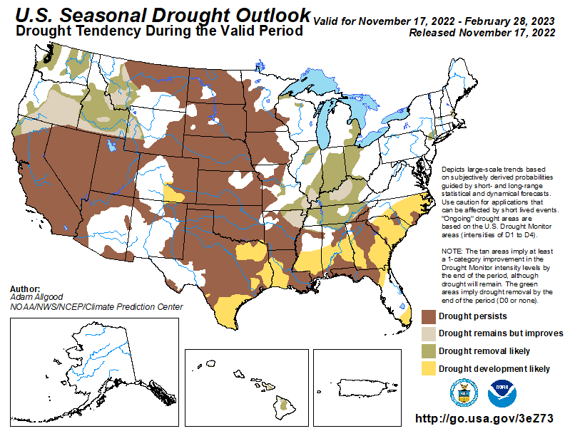
Drought outlook (Nov - Feb)
Drought persistence across Nebraska where it is currently.
Improvements in the northwest and to our east.
https://www.cpc.ncep.noaa.gov/
Notes:
Here I outlined the similar trends for the Nebraska and global annual average temperature. I also point out the high variability in Nebraska and difference in regional vs. global scales. I use the analogy that global change is like an escalator that is increasing at an accelerating rate. The variability is like we jump up or down a few steps while still going up.

Slide 22
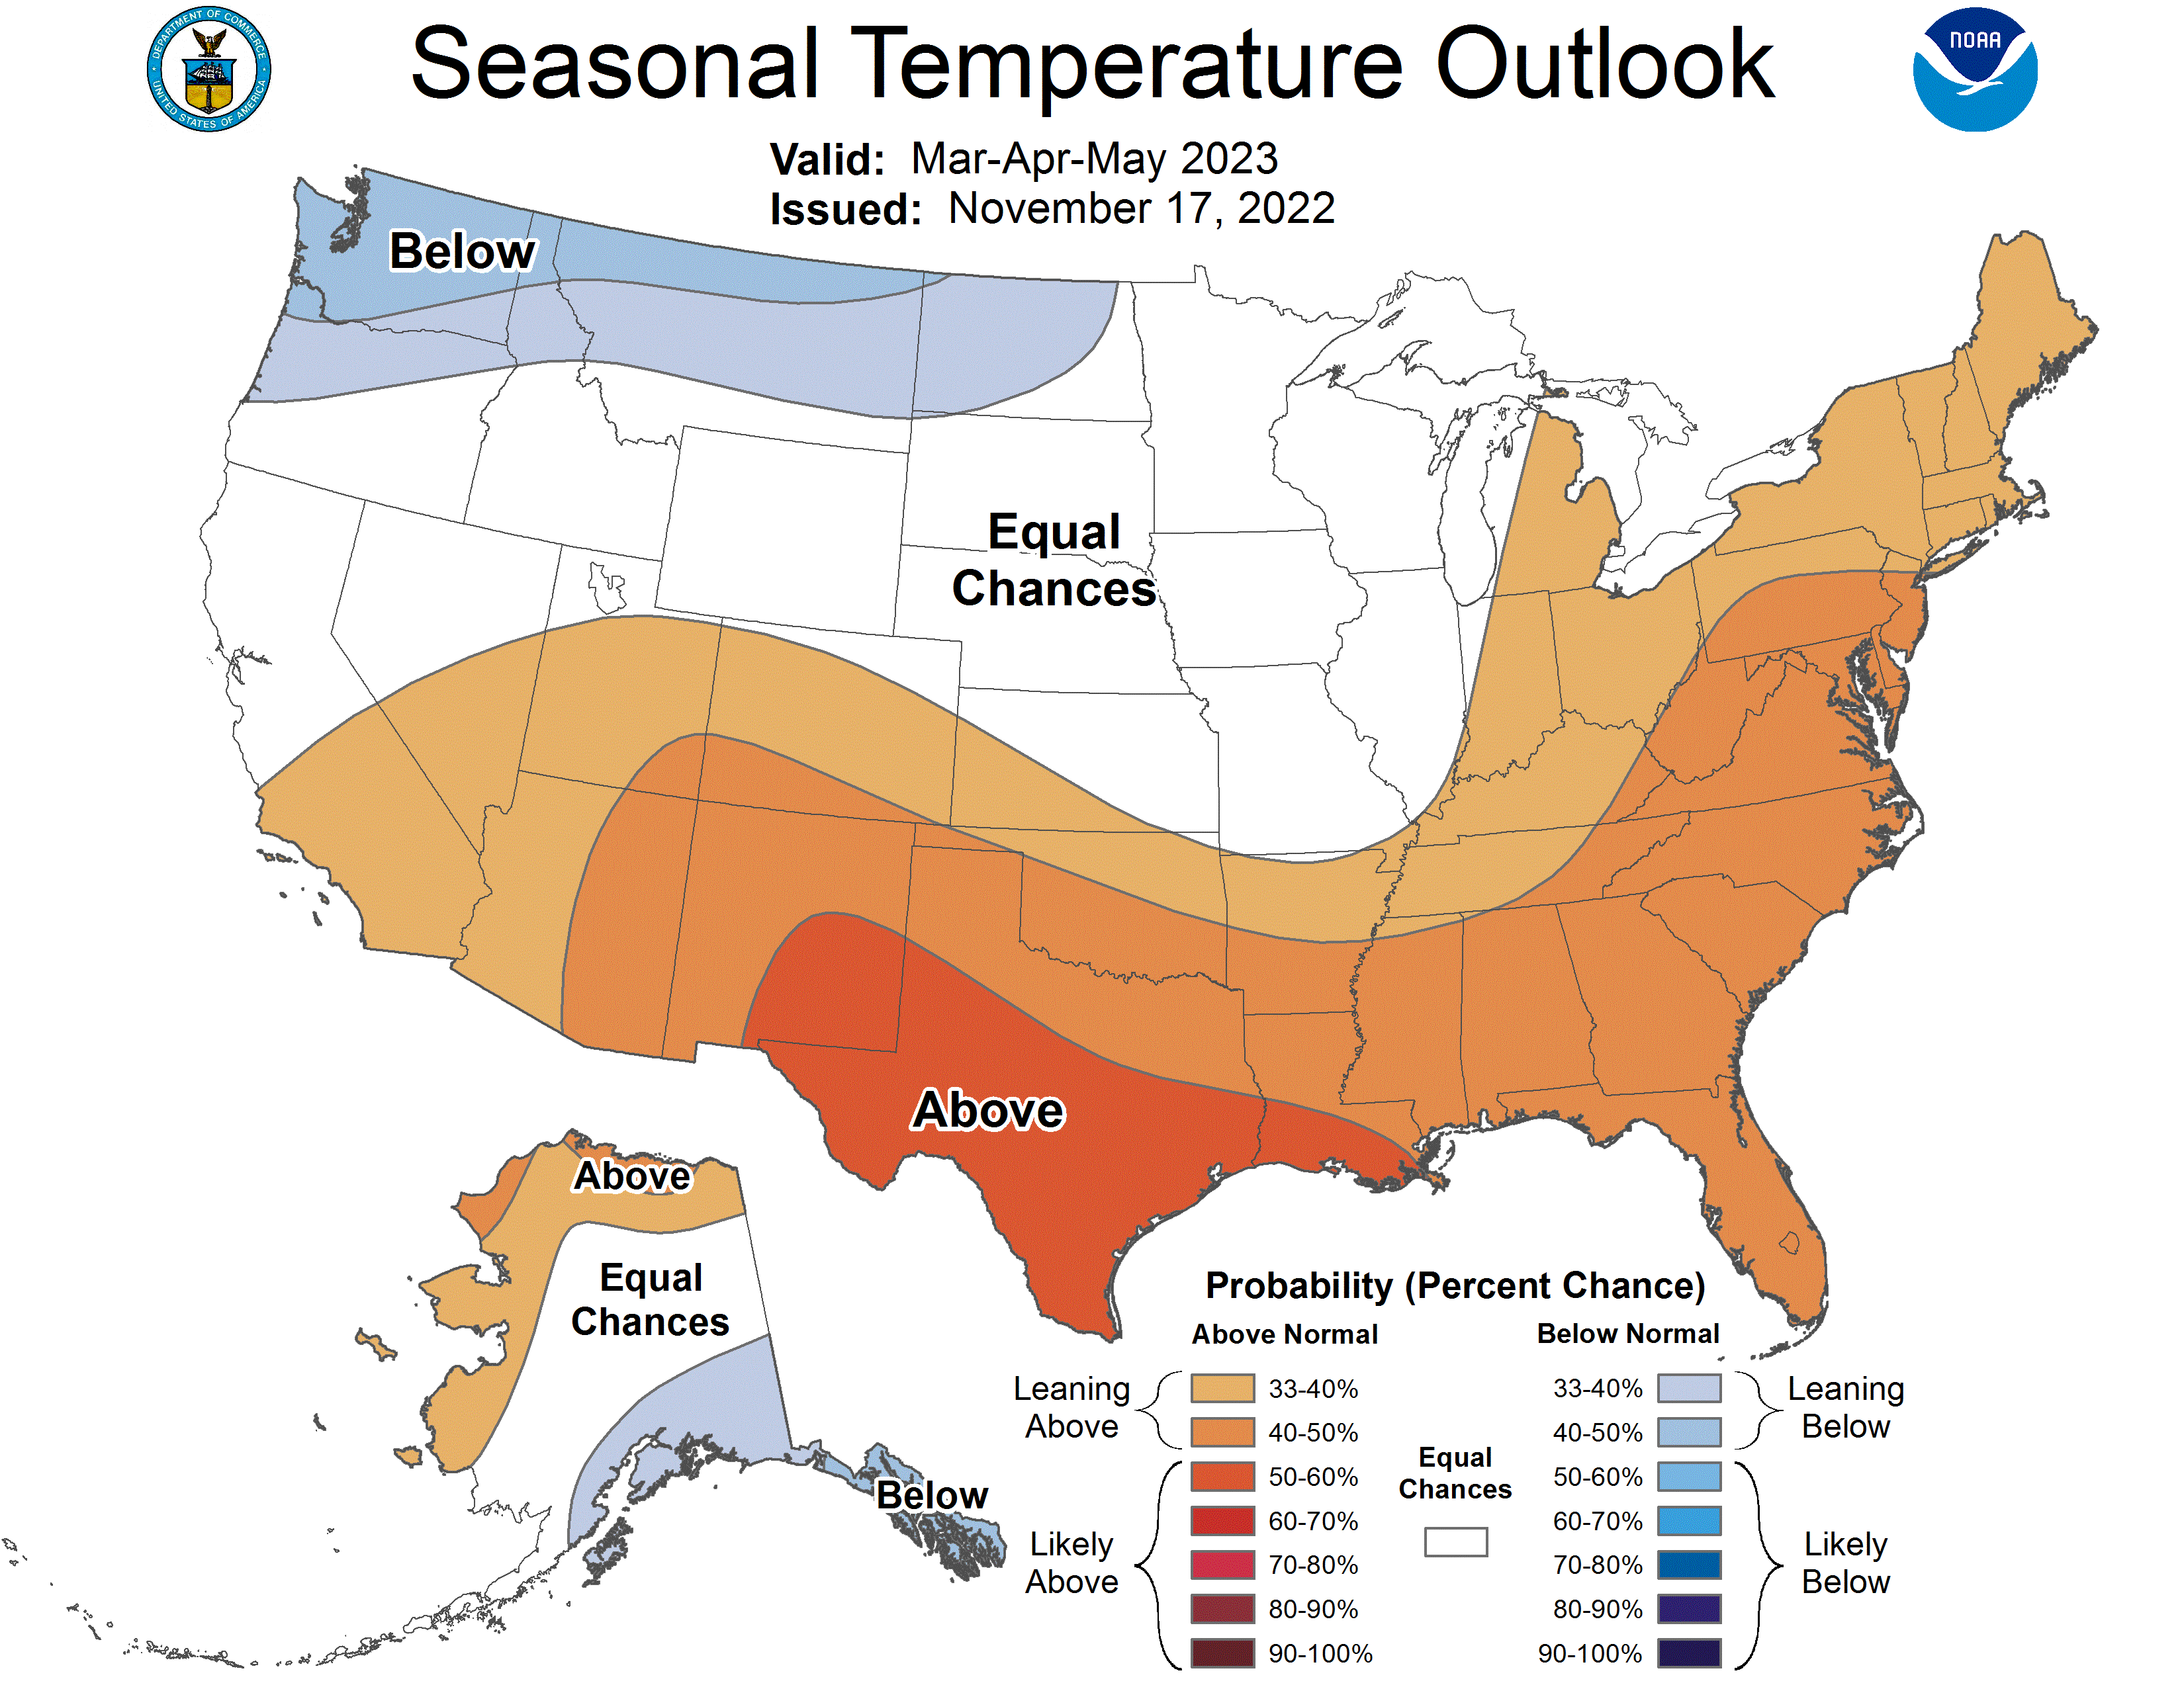
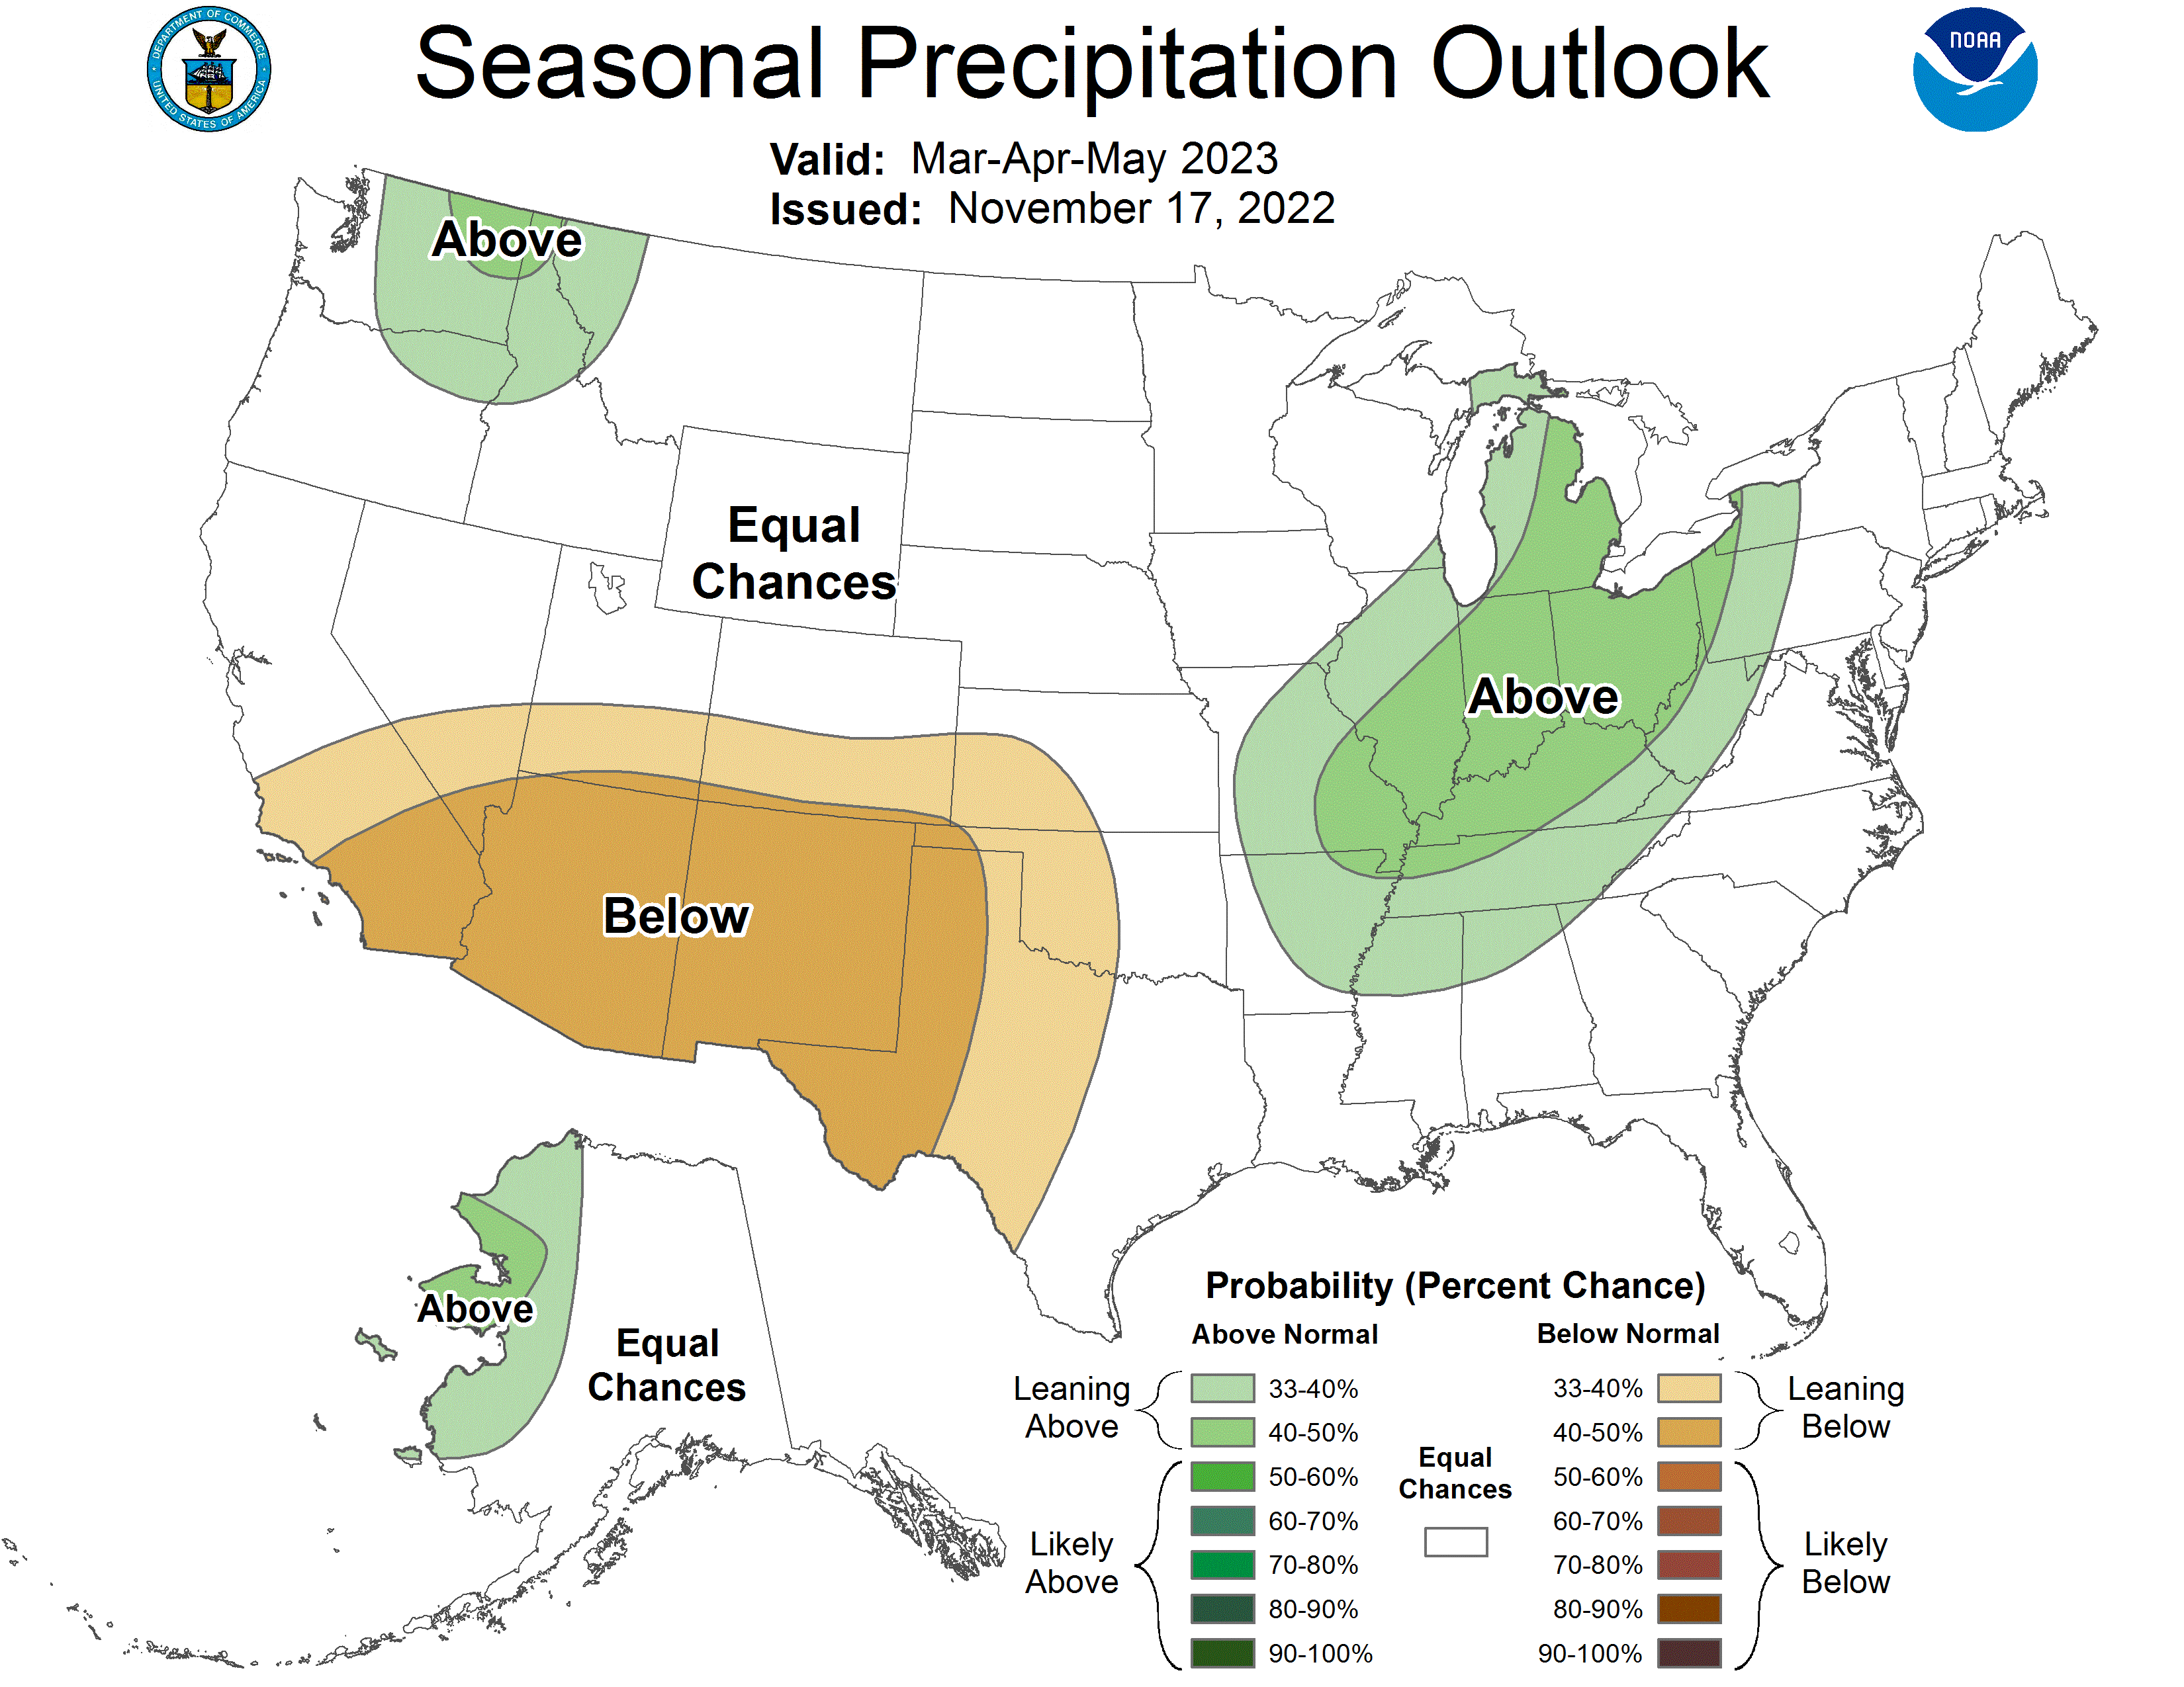
Seasonal outlook (Mar - May)
- Cold/wet signal dampened in spring outlook as we likely begin to come out of La Niña pattern and transition to neutral. Nebraska remains in equal chances.
https://www.cpc.ncep.noaa.gov/
Notes:
Here I outlined the similar trends for the Nebraska and global annual average temperature. I also point out the high variability in Nebraska and difference in regional vs. global scales. I use the analogy that global change is like an escalator that is increasing at an accelerating rate. The variability is like we jump up or down a few steps while still going up.

Slide 23
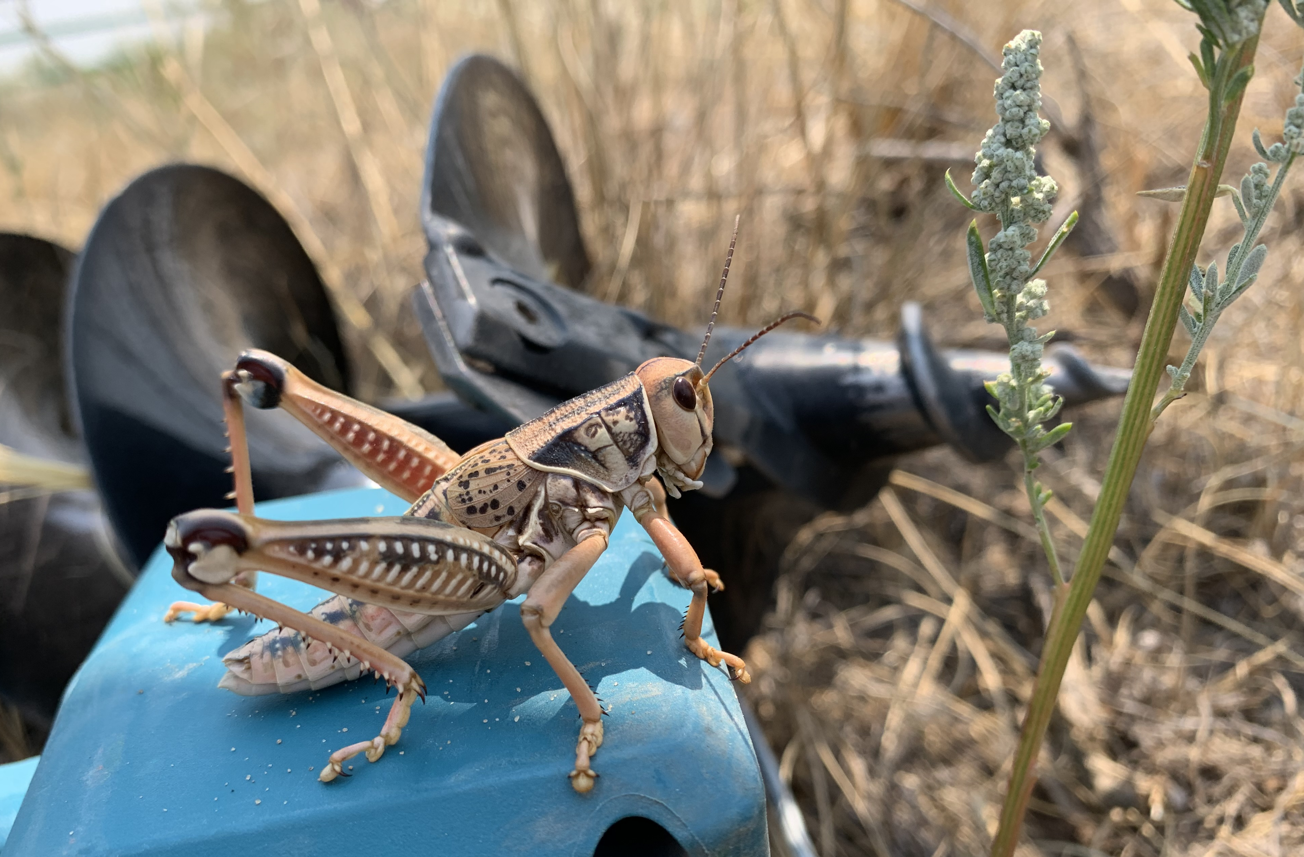
Key Messages
Highest moisture deficits are for northeast and southwest Nebraska (> 20 inches accumulated over the past three years).
Eastern Nebraska has been on eastern edge of dryness with recent intensification this year.
La Niña conditions expected to persist for third straight year (wet/cold across Northern U.S.; warm/dry across Southern U.S.). Potential is in place for cold and possibly snowy end of winter.
Winter is our driest season (8% of our annual moisture). Widespread drought improvements are not expected over next few months.
Notes:
Here I outlined the similar trends for the Nebraska and global annual average temperature. I also point out the high variability in Nebraska and difference in regional vs. global scales. I use the analogy that global change is like an escalator that is increasing at an accelerating rate. The variability is like we jump up or down a few steps while still going up.

Slide 24
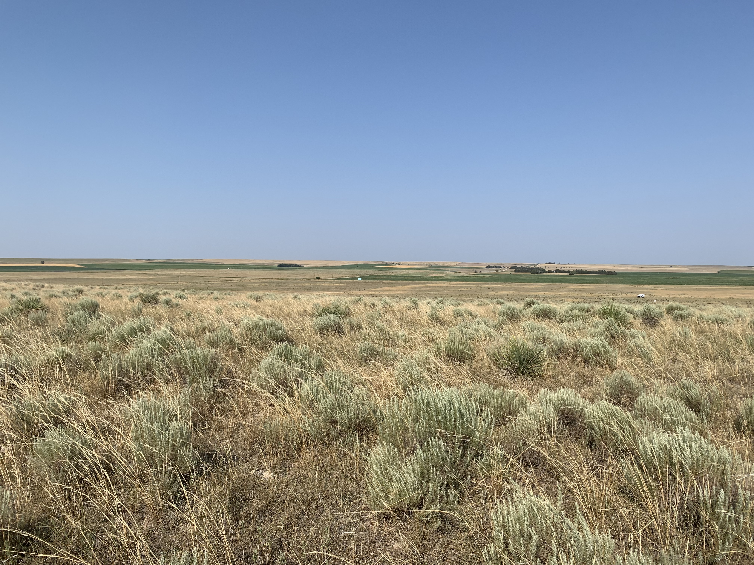
Key Messages
Expected transition out of La Niña to neutral conditions by next spring/summer, which could signal pattern change brining more moisture and some drought relief.
Drought alleviation will take some time. Recharge in short term will depend on soil temperature. Need above normal rainfall during our wet season.
Notes:
Here I outlined the similar trends for the Nebraska and global annual average temperature. I also point out the high variability in Nebraska and difference in regional vs. global scales. I use the analogy that global change is like an escalator that is increasing at an accelerating rate. The variability is like we jump up or down a few steps while still going up.

Slide 25
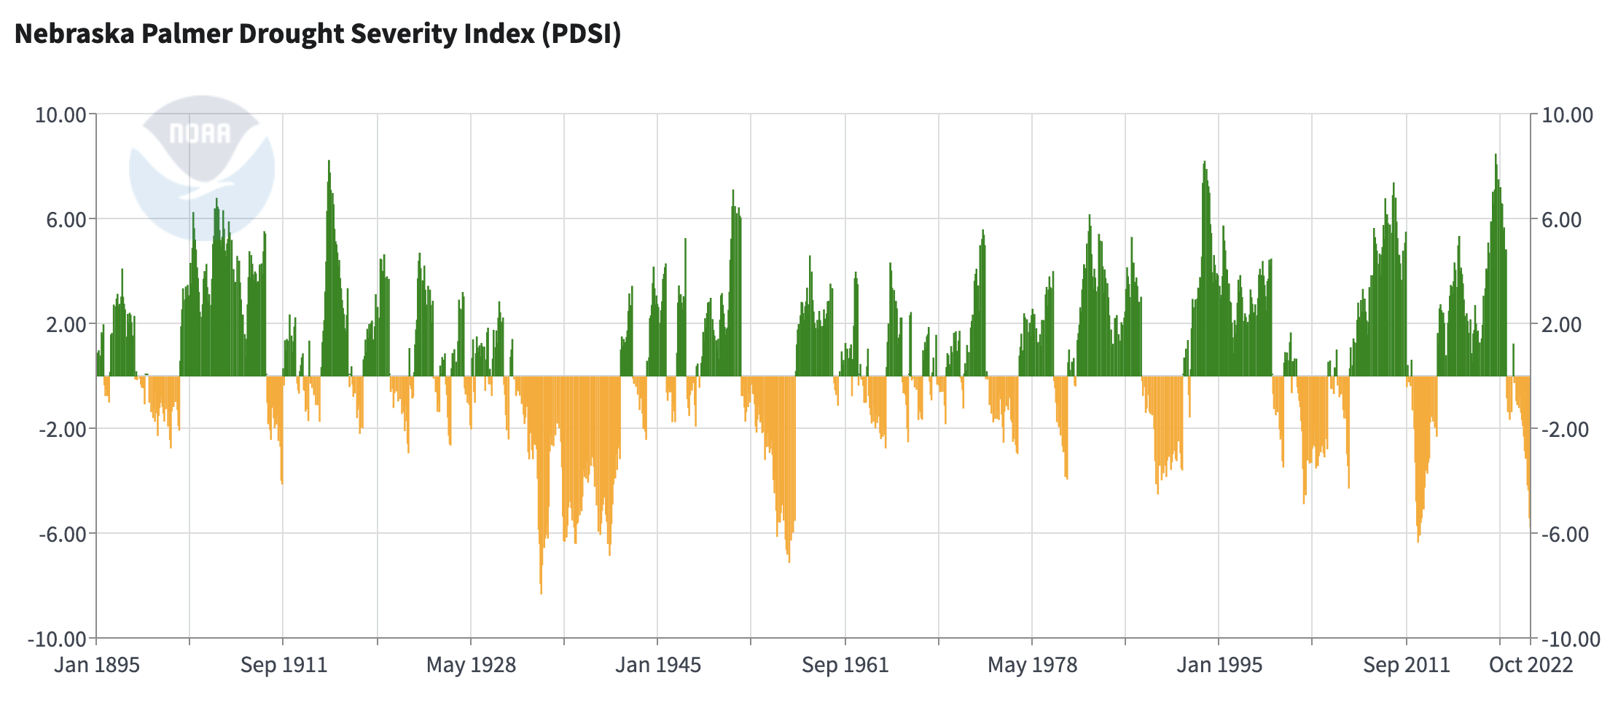
Cycles in the Climate Crossroads
Notes:
Here I outlined the similar trends for the Nebraska and global annual average temperature. I also point out the high variability in Nebraska and difference in regional vs. global scales. I use the analogy that global change is like an escalator that is increasing at an accelerating rate. The variability is like we jump up or down a few steps while still going up.

Slide 26
mdurr9@unl.edu 402-472-6711

Slide 27
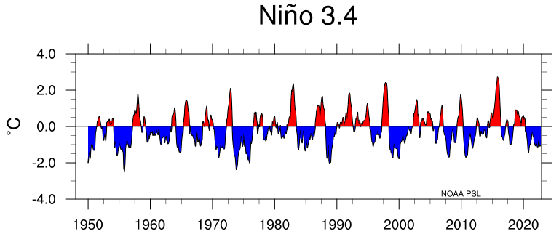
El Niño / Southern Oscillation
Notes:
Here I outlined the similar trends for the Nebraska and global annual average temperature. I also point out the high variability in Nebraska and difference in regional vs. global scales. I use the analogy that global change is like an escalator that is increasing at an accelerating rate. The variability is like we jump up or down a few steps while still going up.

